Slide 1
EXPLORING
TIME
TIME
TIME TO THE MINUTE
LESSON 2

Slide 2
TODAY’S OBJECTIVE
Today we will tell time to
the nearest minute.

Slide 3
TAKE OUT YOUR
MATH JOURNALS
MATH JOURNALS

Slide 4
WATCH ME FIRST

Slide 5
In the previous lesson, we made a clock and told the time to the nearest five minutes.
Today we’ll tell time to the nearest minute.

Slide 6
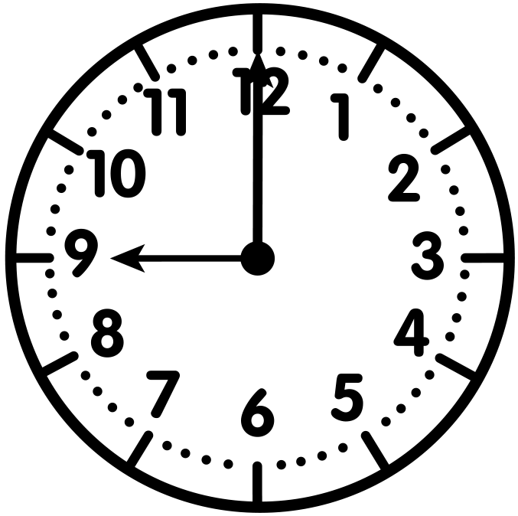
Vocabulary Highlight
An analog clock has a face with numbers 1-12 on it and moving hands (hour and minute).

Slide 7
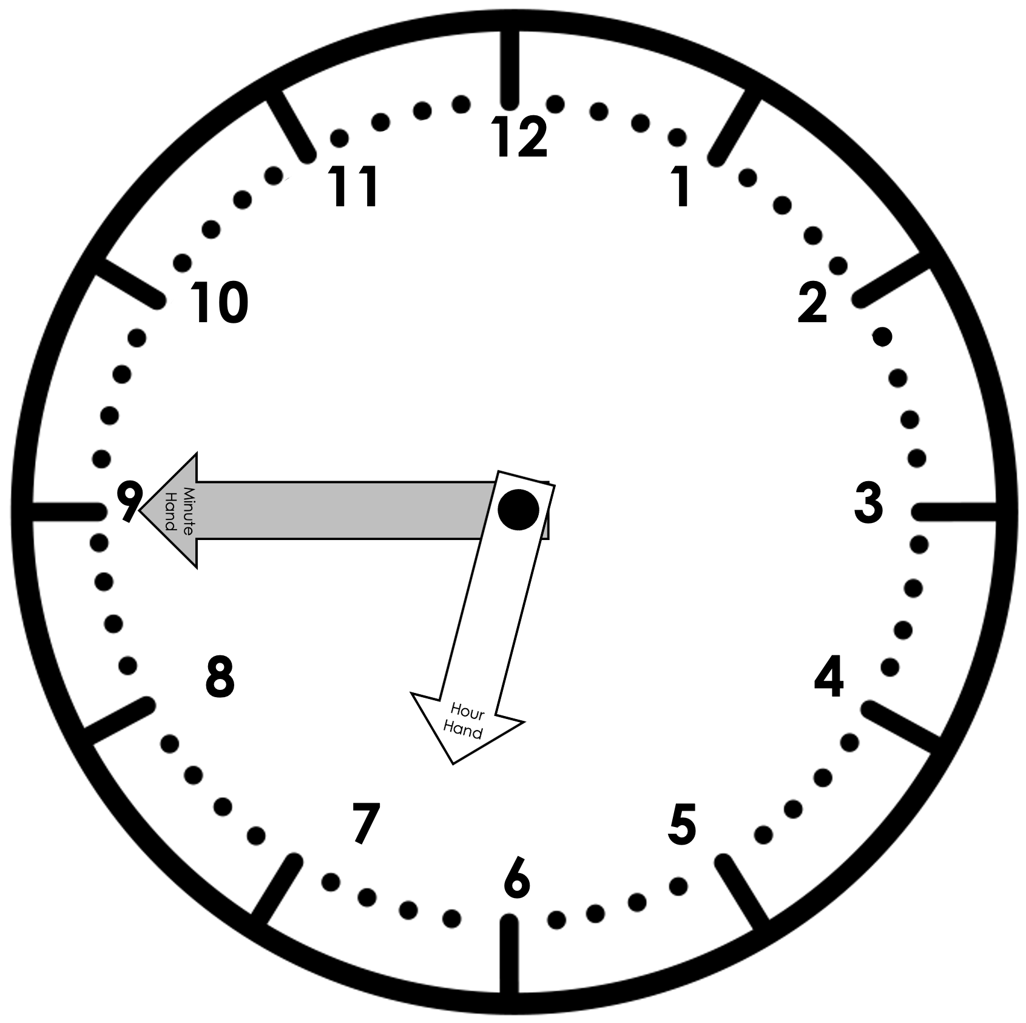
Let’s Review!
Analog clocks have two hands.
The short hand is the hour hand.
The long hand is the minute hand.

Slide 8
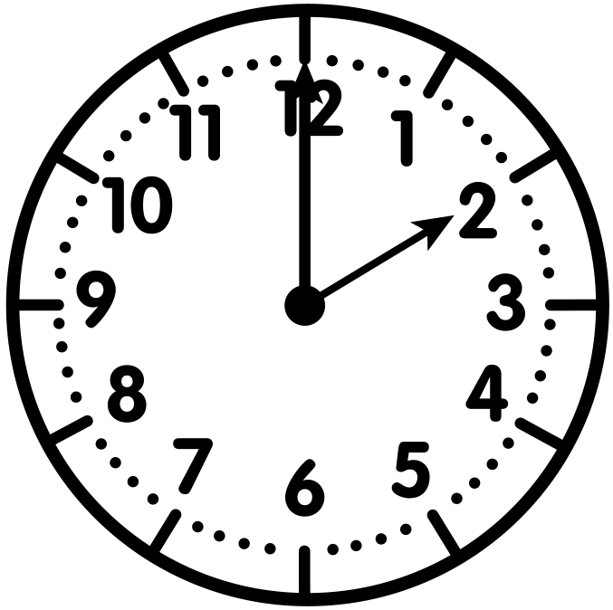
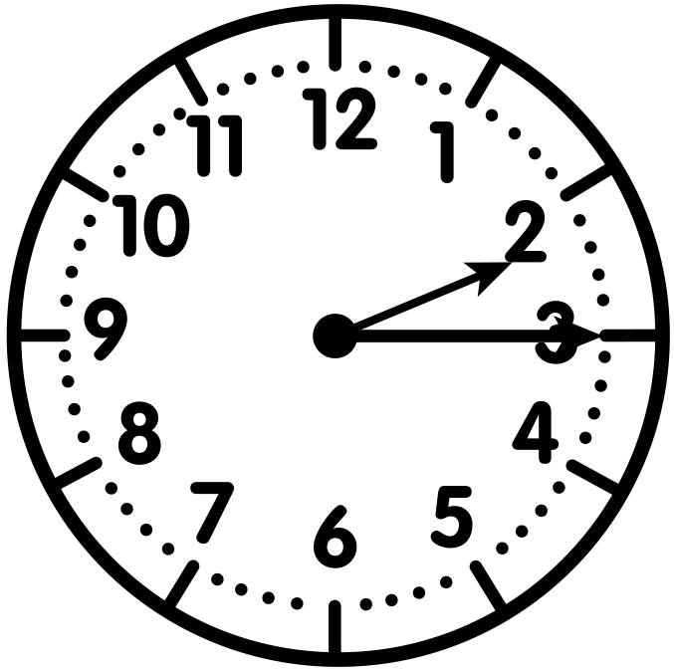
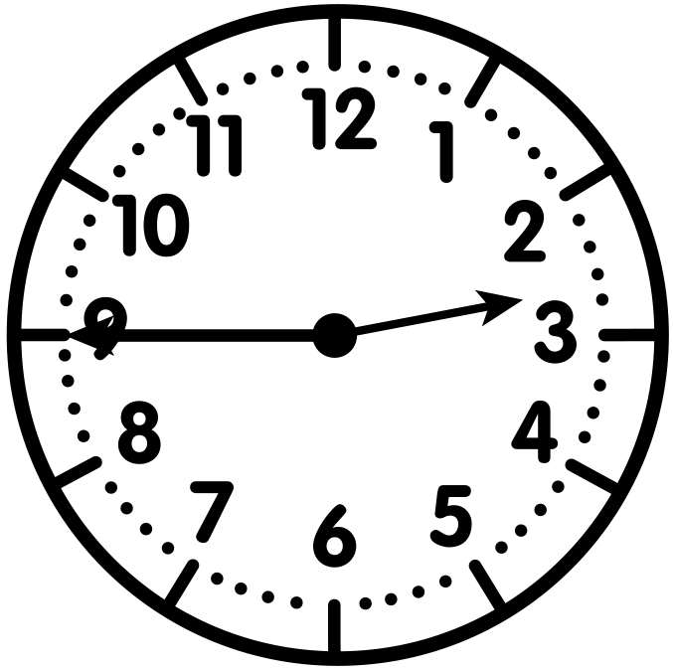
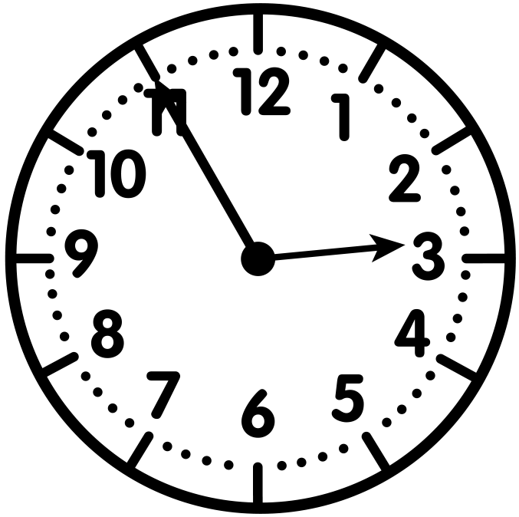
Let’s Review!
2:00
2:15
2:30
2:45
2:55
As it gets later, the hour hand moves towards the next hour.
In the examples above the hour is still 2 o’clock even though the hour hand is not pointing directly at 2.

Slide 9
Watch as I solve a problem to the nearest minute.

Slide 10
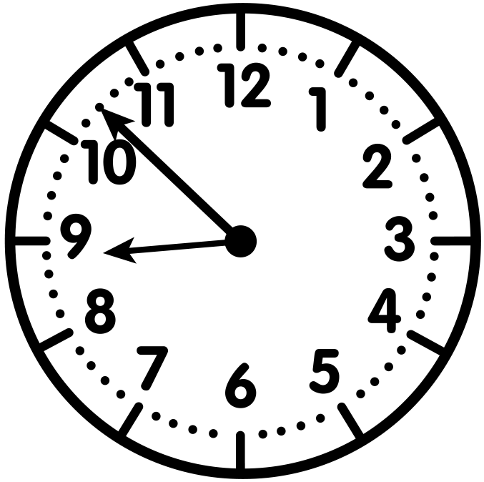
WATCH ME FIRST
Pat has a dentist appointment in the morning. Using the clock, what time is her appointment?
As time passes, the hour hand moves.
The hour hand is between 8 and 9, so the hour is 8.

Slide 11
WATCH ME FIRST
Pat has a dentist appointment in the morning. Using the clock, what time is her appointment?
5
52
51
50
10
Now it’s time to find the minutes
by looking at the minute hand.
45
15
I’ll skip count by 5
and then count on by 1.
40
20
It’s 52 minutes past the hour.
35
25
30

Slide 12
WATCH ME FIRST
Pat has a dentist appointment in the morning. Using the clock, what time is her appointment?
5
52
51
50
10
15
Pat’s appointment is in the morning at 8:52 a.m.
45
40
20
35
25
30

Slide 13
LET’S WORK TOGETHER

Slide 14
Let’s work together to tell time
to the nearest minute.

Slide 15
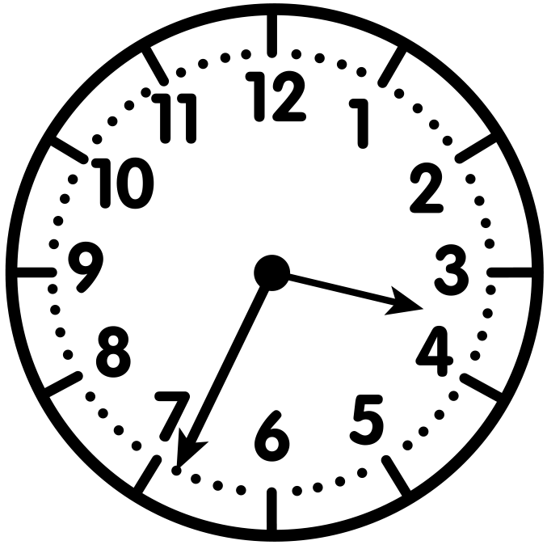
Problem #1
Sunday afternoon, Jessie baked cookies. He took them out of the oven at the time shown on the clock. What time were the cookies done?
LET’S WORK TOGETHER
Which hand do we look at
to find the hour?
The short hand shows the hour.

Slide 16
Problem #1
Sunday afternoon, Jessie baked cookies. He took them out of the oven at the time shown on the clock. What time were the cookies done?
LET’S WORK TOGETHER
What is the hour? Explain.
As time passes, the hour hand moves from 3 to 4.
Here the hour hand is between 3 and 4, it is still 3.

Slide 17
Problem #1
Sunday afternoon Jessie baked cookies. He took them out of the oven at the time shown on the clock. What time were the cookies done?
LET’S WORK TOGETHER
0
5
How many minutes past the hour is it? How do you know?
10
15
It’s 34 minutes past the hour.
We can skip count by 5 and then count by 1.
20
34
25
33
32
30
31

Slide 18
Problem #1
Sunday afternoon Jessie baked cookies. He took them out of the oven at the time shown on the clock. What time were the cookies done?
LET’S WORK TOGETHER
0
5
What time were the cookies done?
Write in your Math Journal.
10
15
They were done at 3:34 p.m.
20
34
25
33
32
30
31

Slide 19
LET’S DO ONE MORE TOGETHER…

Slide 20
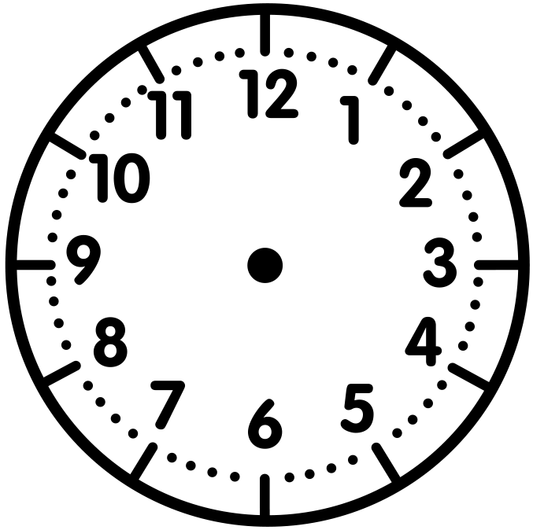
Problem #2
If the hour hand is pointing toward 8 and the minute hand is pointing directly at 9, what time is it?
LET’S WORK TOGETHER
Draw the hour hand and minute hand on the clock.
Record in your Math Journal.
What time is it?
It is 7:45.

Slide 21
CHECK - IN
What did you notice?
Can you make a connection to anything else you already know? How?
Do you have any questions?

Slide 22
IT’S YOUR TURN

Slide 23
Time to Discuss and
Check Your Answers
How did you solve it?

Slide 24
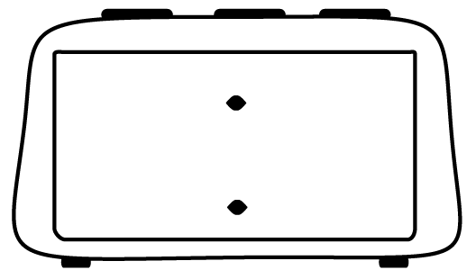
Problem #1
YOUR TURN
Draw the minute hand on the clocks to show the
correct times.
1:22
10:56

Slide 25
Problem #1
YOUR TURN
Draw the minute hand on the clocks to show the
correct times.
1:22
10:56

Slide 26
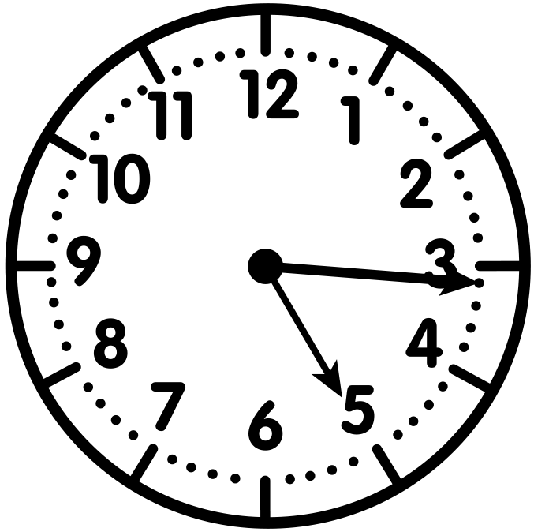
Problem #2
YOUR TURN
After school, Cameron started his homework at the time on the clock. What time did he start?

Slide 27
Problem #2
YOUR TURN
After school, Cameron started his homework at the time on the clock. What time did he start?
Cameron started his homework at 5:16 p.m.

Slide 28
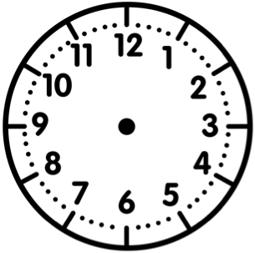
Problem #3
YOUR TURN
The hour hand is between 1 and 2. The minute hand is pointing at 6. Draw the hands and write the time in the digital clock.

Slide 29
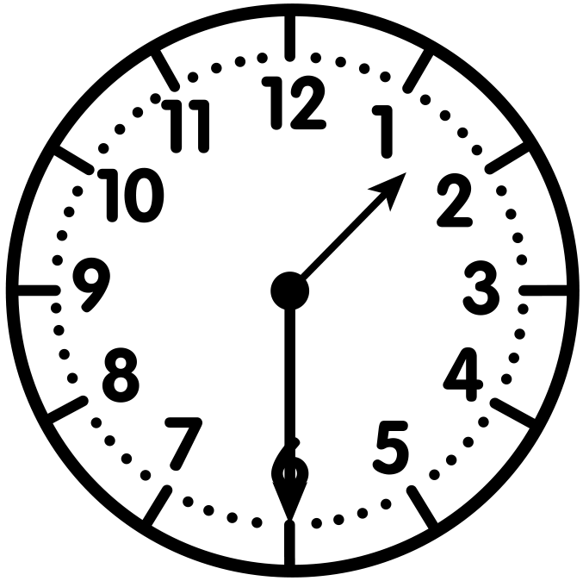
Problem #3
YOUR TURN
The hour hand is between 1 and 2. The minute hand is pointing at 6. Draw the hands and write the time in the digital clock.
1:30

Slide 30
Problem #4
YOUR TURN
Draw the minute hand on the clocks to show the
correct times.
5:43
12:17

Slide 31
Problem #4
YOUR TURN
Draw the minute hand on the clocks to show the
correct times.
5:43
12:17

Slide 32
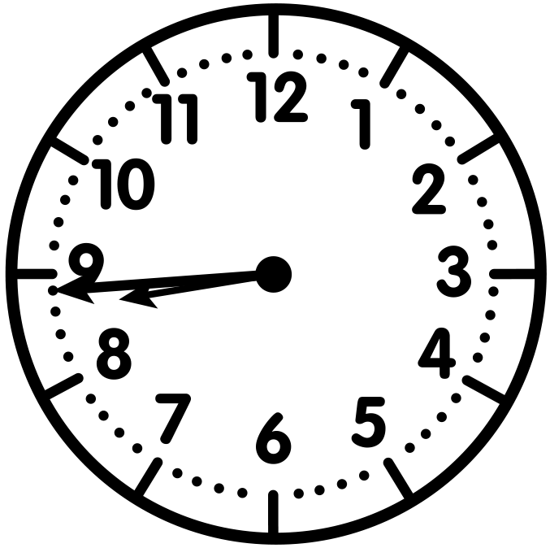
Problem #5
YOUR TURN
Saturday morning, Kim went to the park at the time shown on the clock. What time did she go?

Slide 33
Problem #5
YOUR TURN
Saturday morning, Kim went to the park at the time shown on the clock. What time did she go?
Kim went to the park at 8:44 a.m.

Slide 34
Problem #6
YOUR TURN
The hour hand is pointing towards 8. The minute hand is pointing to 10. Draw the clock hands. Write the time in the digital clock.

Slide 35
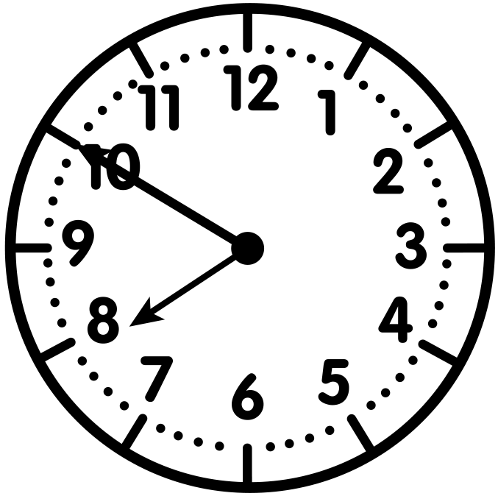
Problem #6
YOUR TURN
The hour hand is pointing towards 8. The minute hand is pointing to 10. Draw the clock hands. Write the time in the digital clock.
7:50

Slide 36
Let’s Reflect
It’s Reflection Time!

