Slide 1
EXPLORING
TIME
TIME
INTRODUCTION
TO NUMBER LINES
LESSON 4

Slide 2
TODAY’S OBJECTIVE
Today we will plot time to the nearest five minutes on a number line.

Slide 3
TAKE OUT YOUR
MATH JOURNALS
MATH JOURNALS

Slide 4
WATCH ME FIRST

Slide 5
Today we’ll use number
lines to plot time.
Let’s review number lines!

Slide 6
WATCH ME FIRST
Number lines are usually broken up into equal segments.

Slide 7
WATCH ME FIRST
We can mark end points on number lines.
0
10

Slide 8
WATCH ME FIRST
The numbers on a number line decrease as you move left…
0
1
2
3
4
5
6
7
8
9
10

Slide 9
WATCH ME FIRST
…and increase as you move right.
0
1
2
3
4
5
6
7
8
9
10

Slide 10
WATCH ME FIRST
Number lines can show more than whole numbers. They can show any type of number like time or fractions.
1:00
1:30
2:00
0

Slide 11
We’re going to explore time on a number line.
One way to show time on a number line is with 5-minute intervals.
0
60
minutes
minutes

Slide 12
WATCH ME FIRST
My number line will show
1 hour. There are 60 minutes in 1 hour.

Slide 13
WATCH ME FIRST
I’ll start my number line at 0 minutes.
I’ll end my number line at 60 minutes.
0
60
minutes
minutes

Slide 14
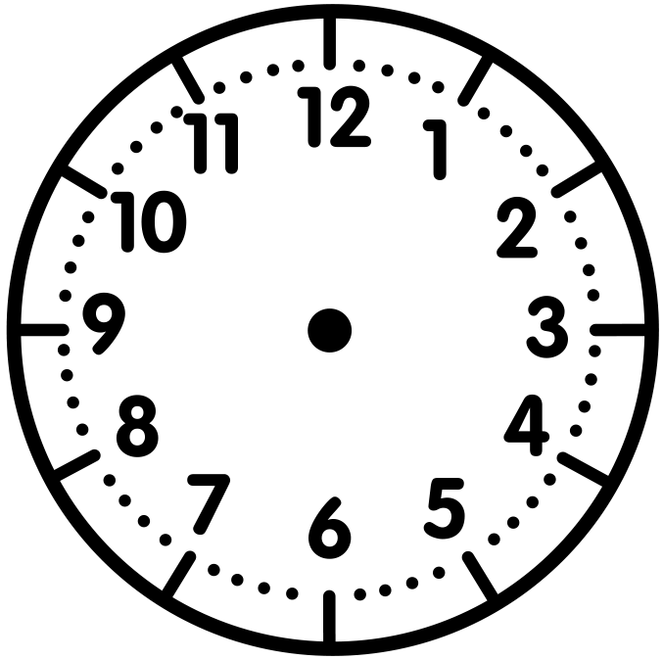
WATCH ME FIRST
A clock is like a number line except the line curves around the clock.
0
60
minutes
minutes

Slide 15
WATCH ME FIRST
60
0
I’ll start at zero minutes on both the clock and the number line and stop at 60 minutes.
0
60
minutes
minutes

Slide 16
WATCH ME FIRST
60
0
55
5
10
I can skip count by 5-minute intervals to get to 60 minutes.
50
15
45
20
40
35
25
30
0
5
10
15
20
25
30
35
40
45
50
55
60
minutes
minutes

Slide 17
WATCH ME FIRST
60
0
55
5
Each segment in this
number line is 5 minutes long. And just like a clock, there are numbers between each segment.
10
50
15
45
20
40
35
25
30
1
2
3
4
0
5
10
15
20
25
30
35
40
45
50
55
60
minutes
minutes

Slide 18
WATCH ME FIRST
60
0
55
5
10
50
Awesome!
Which numbers are between 5 and 10 minutes?
15
45
20
40
35
25
30
1
2
3
4
6
7
8
9
0
5
10
15
20
25
30
35
40
45
50
55
60
minutes
minutes

Slide 19
WATCH ME FIRST
60
0
55
5
10
50
Today we will focus on plotting time to the nearest five minutes.
15
45
20
40
35
25
30
1
2
3
4
6
7
8
9
0
5
10
15
20
25
30
35
40
45
50
55
60
minutes
minutes

Slide 20
WATCH ME FIRST
60
0
55
5
10
50
I can show different times on my clock and my number line.
15
45
20
40
35
25
30
0
5
10
15
20
25
30
35
40
45
50
55
60
minutes
minutes

Slide 21
WATCH ME FIRST
60
0
55
5
10
50
I’ll draw clock hands to show 1:00.
15
45
20
40
35
25
30
0
5
10
15
20
25
30
35
40
45
50
55
60
minutes
minutes

Slide 22
WATCH ME FIRST
60
0
55
5
10
50
Watch me plot 1:00 on my number line.
1:00
15
45
20
40
35
25
30
0
5
10
15
20
25
30
35
40
45
50
55
60
minutes
minutes

Slide 23
WATCH ME FIRST
60
0
55
5
10
50
1:15
Now, watch me plot 1:15
15
45
20
40
35
25
1:00
30
0
5
10
15
20
25
30
35
40
45
50
55
60
minutes
minutes

Slide 24
WATCH ME FIRST
60
0
55
5
10
50
1:30
Last, watch me plot 1:30.
15
45
20
40
35
25
1:00
30
1:15
0
5
10
15
20
25
30
35
40
45
50
55
60
minutes
minutes

Slide 25
LET’S WORK TOGETHER

Slide 26
Now let’s work together to
plot times on number lines.

Slide 27
Problem #1a
Carlos arrived at the amusement park at 3:00.
In your Math Journal, draw the clock hands to show his arrival time.
LET’S WORK TOGETHER
In your Math Journal, plot the time on the number line.
0
5
10
15
20
25
30
35
40
45
50
55
60
minutes
minutes

Slide 28
Problem #1a
LET’S WORK TOGETHER
Is this the correct place to plot 3:00? Why?
3:00
0
5
10
15
20
25
30
35
40
45
50
55
60
minutes
minutes

Slide 29
Problem #1b
At 3:20, Carlos rode on a roller coaster. Draw the clock hands to show the time in your Math Journal.
LET’S WORK TOGETHER
Plot the time on the number line in your Math Journal.
3:00
0
5
10
15
20
25
30
35
40
45
50
55
60
minutes
minutes

Slide 30
Problem #1b
At 3:20, Carlos rode on a roller coaster. Draw clock hands to show the time in your Math Journal.
LET’S WORK TOGETHER
How did you plot the time
on the number line?
We can count by 5 to
get to 3:20.
3:00
3:20
+5
+5
+5
+5
0
5
10
15
20
25
30
35
40
45
50
55
60
minutes
minutes

Slide 31
Problem #1c
At 3:40, Carlos bought a funnel cake. Draw the clock hands to show the time in your Math Journal.
LET’S WORK TOGETHER
Plot the time on the number line in your Math Journal.
3:00
3:20
0
5
10
15
20
25
30
35
40
45
50
55
60
minutes
minutes

Slide 32
Problem #1c
At 3:40 Carlos bought a funnel cake. Draw the clock hands to show the time in your Math Journal.
LET’S WORK TOGETHER
How did you plot the time
on the number line?
We can count by five to get to 3:40.
3:00
3:20
3:40
+5
+5
+5
+5
+5
+5
+5
+5
0
5
10
15
20
25
30
35
40
45
50
55
60
minutes
minutes

Slide 33
LET’S DO ONE MORE TOGETHER…

Slide 34
Problem #2
LET’S WORK TOGETHER
Sheri went to the aquarium. She recorded the times she saw different exhibits on her tablet. In your Math Journal, fill in the number line and plot each time.
9:10 – Whale Exhibit
9:35 – Saltwater Fish
9:50 – Dolphin Show
9:00
10:00
0
5
10
15
20
25
30
35
40
45
50
55
60
minutes
minutes

Slide 35
Problem #2
LET’S WORK TOGETHER
Sheri went to the aquarium. She recorded the times she saw different exhibits on her tablet. In your Math Journal, fill in the number line and plot each time.
9:10 – Whale Exhibit
9:35 – Saltwater Fish
9:50 – Dolphin Show
Does your number line look like this one?
Let’s Discuss!
Whale Exhibit
Saltwater Fish
Dolphin Show
9:00
9:10
9:35
9:50
10:00
0
5
10
15
20
25
30
35
40
45
50
55
60
minutes
minutes

Slide 36
CHECK - IN
What did you notice?
Can you make a connection to anything else you already know? How?
Do you have any questions?

Slide 37
IT’S YOUR TURN

Slide 38
Time to Discuss and
Check Your Answers
How did you solve it?

Slide 39
Problem #1
YOUR TURN
Fill in the number line. Write the times in the boxes.
7:00
8:00
0
60
minutes
minutes

Slide 40
Problem #1
YOUR TURN
Fill in the number line. Write the times in the boxes.
7:00
7:20
7:45
8:00
0
5
10
15
20
25
30
35
40
45
50
55
60
minutes
minutes

Slide 41
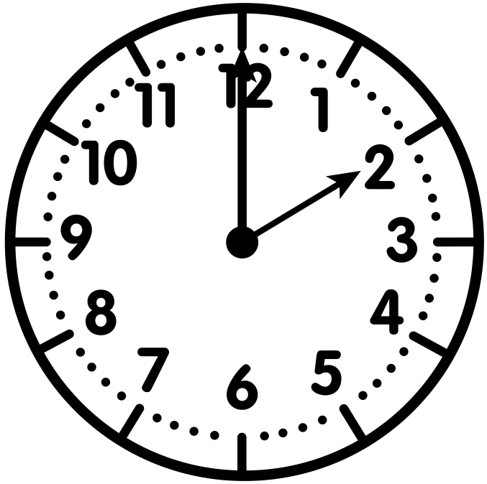
Problem #2
YOUR TURN
Vicky believes the mystery time is 2:55.
Do you agree or disagree? Explain.
?
0
60
minutes
minutes

Slide 42
Problem #2
YOUR TURN
Vicky believes the mystery time is 2:55.
Do you agree or disagree? Explain.
2:50
?
0
5
10
15
20
25
30
35
40
45
50
55
60
minutes
minutes
Disagree. The mystery time is 2:50 and not 2:55.

Slide 43
Problem #3
YOUR TURN
Chloe went to the zoo. She saw different animals and recorded the times below. Fill in the number line and plot the times.
Zoo Agenda
Snakes ….. 11:05
Elephants ….. 11:15
Alligators ….. 11:30
Lions ….. 11:45
11:00
12:00
0
60
minutes
minutes

Slide 44
Problem #3
YOUR TURN
Chloe went to the zoo. She saw different animals and recorded the times below. Fill in the number line and plot the times.
Zoo Agenda
Snakes ….. 11:05
Elephants ….. 11:15
Alligators ….. 11:30
Lions ….. 11:45
snakes
elephants
alligators
lions
11:00
11:05
11:15
11:30
11:45
12:00
0
5
10
15
20
25
30
35
40
45
50
55
60
minutes
minutes

Slide 45
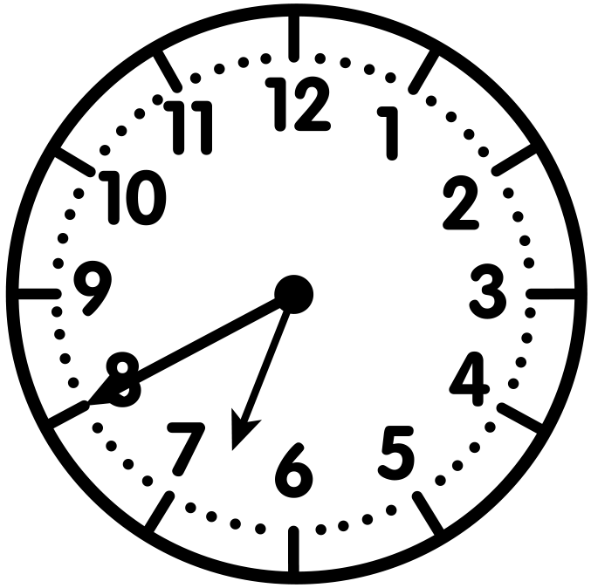
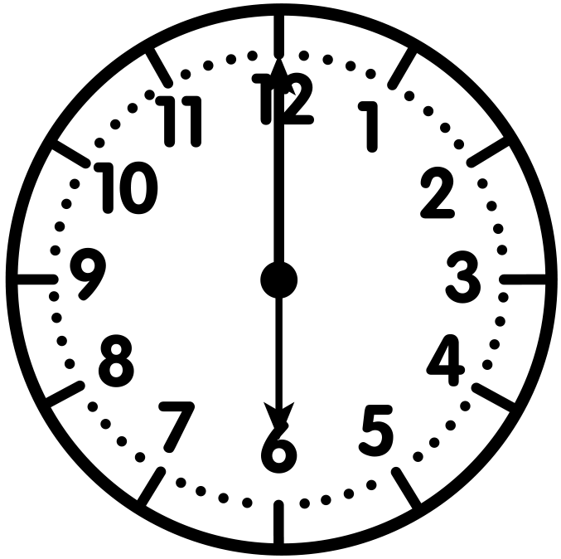
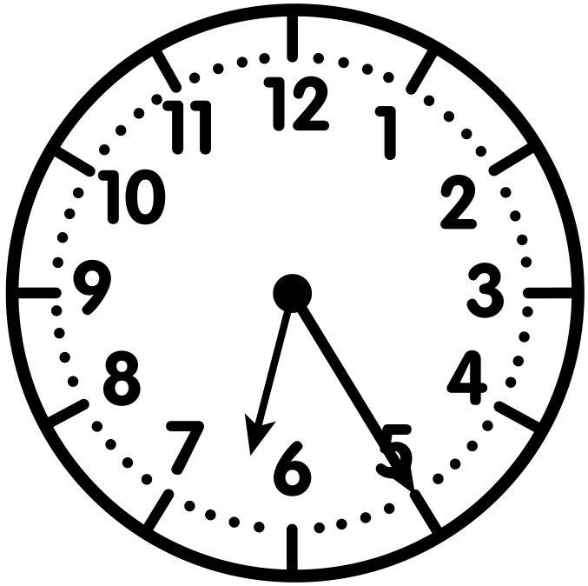
Problem #4
YOUR TURN
Each clock is assigned a letter.
Plot the time and the matching letters on the number line.
A | B | C
0
5
10
15
20
25
30
35
40
45
50
55
60
minutes
minutes

Slide 46
Problem #4
YOUR TURN
Each clock is assigned a letter.
Plot the time and the matching letters on the number line.
A | B | C
B
C
A
7:00
6:00
6:25
6:40
0
5
10
15
20
25
30
35
40
45
50
55
60
minutes
minutes

Slide 47
Problem #5
Greg went to the park at 8:30. Draw clock hands and plot the time on the number line.
YOUR TURN
8:00
9:00
0
60
minutes
minutes

Slide 48
Problem #5
Greg went to the park at 8:30. Draw clock hands and plot the time on the number line.
YOUR TURN
8:00
8:30
9:00
0
5
10
15
20
25
30
35
40
45
50
55
60
minutes
minutes

Slide 49
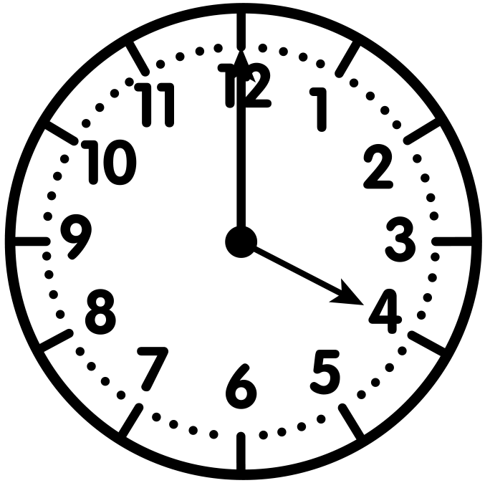
Problem #6
YOUR TURN
Sam believes the mystery time is 4:15.
Do you agree or disagree? Explain.
?
0
60
minutes
minutes

Slide 50
Problem #6
YOUR TURN
Sam believes the mystery time is 4:15.
Do you agree or disagree? Explain.
4:15
?
0
5
10
15
20
25
30
35
40
45
50
55
60
minutes
minutes
Agree. The mystery time is 4:15.

Slide 51
Let’s Reflect
It’s Reflection Time!

