Slide 1
EXPLORING
TIME
TIME
ELAPSED TIME USING
NUMBER LINES (PART 2)
LESSON 6

Slide 2
TODAY’S OBJECTIVE
Today we will use number
lines to find elapsed time.

Slide 3
TAKE OUT YOUR
MATH JOURNALS
MATH JOURNALS

Slide 4
WATCH ME FIRST

Slide 5
In the previous lesson, we solved elapsed time problems within one hour.
Today we’ll solve elapsed time problems within one hour and a half.
Let’s review elapsed time!

Slide 6
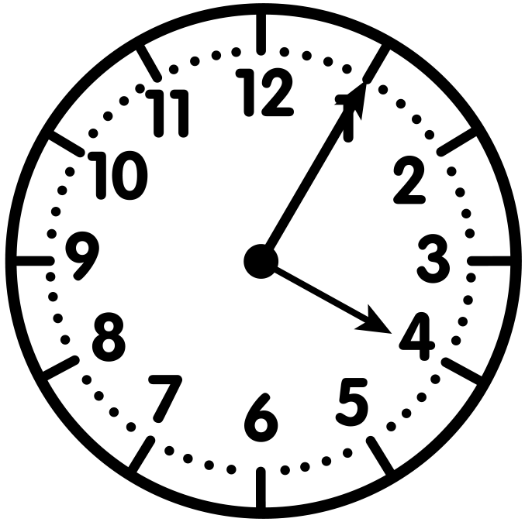
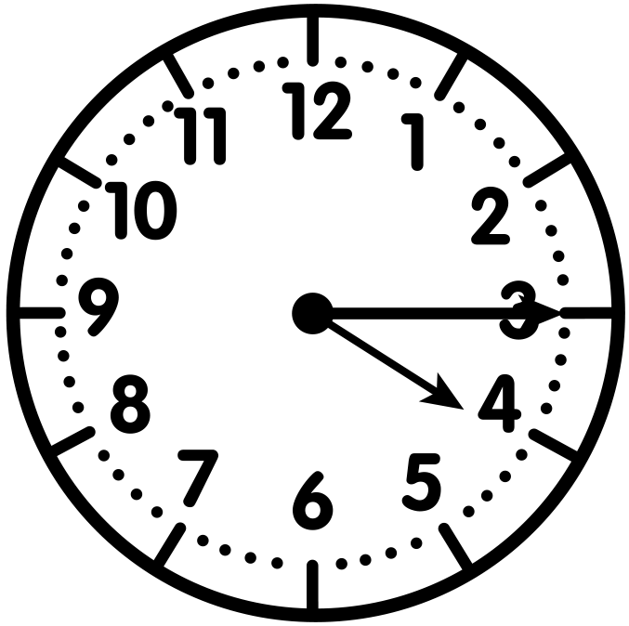
Vocabulary Highlight
Elapsed time is the amount of time that passes from the start of an event until its end.
Start Time - 4:05
End Time - 4:15
This activity is 10 minutes long.

Slide 7
What is a Segment on a Number Line?
Segments are the spaces on a number line between two plotted points or tick marks .
segment
1:00
1:10
1:20
1:30
Each segment represents 10 minutes.

Slide 8
We’ll focus on time problems
within one hour and a half where
we know the start and end
times of the activity.
2:30
4:00

Slide 9
WATCH ME FIRST
Jessica went to the afterschool program at 2:35. Her mom picked her up at 3:41. How long was Jessica at the program?
I’m using a number line that’s divided into equal segments to solve this problem.
Jessica attended the program between 2:30 and 4:00 so these are my endpoints.
2:30
2:35
2:40
2:45
2:50
2:55
3:00
3:05
3:10
3:15
3:20
3:25
3:30
3:35
3:40
3:45
3:50
4:00
3:55

Slide 10
WATCH ME FIRST
Jessica went to the afterschool program at 2:35. Her mom picked her up at 3:41. How long was Jessica at the afterschool program?
Each equal segment in this number line represents a 5-minute interval.
2:30
2:35
2:40
2:45
2:50
2:55
3:00
3:05
3:10
3:15
3:20
3:25
3:30
3:35
3:40
3:45
3:50
4:00
3:55
5 mins
5 mins
5 mins
5 mins
5 mins
5 mins
5 mins
5 mins
5 mins
5 mins
5 mins
5 mins
5 mins
5 mins
5 mins
5 mins
5 mins
5 mins

Slide 11
WATCH ME FIRST
Jessica went to the afterschool program at 2:35. Her mom picked her up at 3:41. How long was Jessica at the afterschool program?
First, I’ll locate the start time and the end time to find how much time passed.
2:30
2:35
2:40
2:45
2:50
2:55
3:00
3:05
3:10
3:15
3:20
3:25
3:30
3:35
3:40
3:45
3:50
4:00
2:35
3:55
Start Time
3:41
End Time

Slide 12
WATCH ME FIRST
Jessica went to the afterschool program at 2:35. Her mom picked her up at 3:41. How long was Jessica at the afterschool program?
It’s time to hop along the number line.
I’ll jump by 10.
Now, I’ll jump by 5 and 1.
+10
+10
+10
+10
+10
+10
+5
+1
2:30
2:35
2:40
2:45
2:50
2:55
3:00
3:05
3:10
3:15
3:20
3:25
3:30
3:35
3:40
3:45
3:50
4:00
2:35
3:55
Start Time
3:41
End Time

Slide 13
WATCH ME FIRST
Jessica went to the afterschool program at 2:35. Her mom picked her up at 3:41. How long was Jessica at the afterschool program?
I’ll combine my jumps to find out how long Jessica was in afterschool.
Jessica was at the afterschool program for 66 minutes.
+10
+10
+10
+10
+10
+10
+5
+1
2:30
2:35
2:40
2:45
2:50
2:55
3:00
3:05
3:10
3:15
3:20
3:25
3:30
3:35
3:40
3:45
3:50
4:00
2:35
3:55
66 minutes
Start Time
3:41
End Time

Slide 14
LET’S WORK TOGETHER

Slide 15
Now we’ll work together to solve elapsed time problems.

Slide 16
Problem #1
LET’S WORK TOGETHER
The 5th grade graduation ceremony starts at 10:15. It ends at 11:30. How long is the ceremony?
How many minutes does each equal segment represent in this number line?
Each segment represents 5 minutes.
10:00
10:10
10:15
10:20
10:25
10:30
10:35
10:40
10:45
10:50
10:55
11:00
11:05
11:10
11:15
11:20
11:30
10:05
11:25
5 mins
5 mins
5 mins
5 mins
5 mins
5 mins
5 mins
5 mins
5 mins
5 mins
5 mins
5 mins
5 mins
5 mins
5 mins
5 mins
5 mins
5 mins

Slide 17
Problem #1
LET’S WORK TOGETHER
The 5th grade graduation ceremony starts at 10:15. It ends at 11:30. How long is the ceremony?
Label the start and end times on the number line.
Solve in your
Math Journal.
10:00
11:30
10:10
10:15
10:20
10:25
10:30
10:35
10:40
10:45
10:50
10:55
11:00
11:05
11:10
11:15
11:30
10:05
10:15
11:20
11:25
Start Time
End Time

Slide 18
Problem #1
LET’S WORK TOGETHER
The 5th grade graduation ceremony starts at 10:15. It ends at 11:30. How long is the ceremony?
How long was the ceremony?
Can you think of another way to jump along the number line? Explain.
It was 75 minutes long.
+10
+10
+10
+10
+10
+10
+10
+5
10:00
11:30
10:10
10:15
10:20
10:25
10:30
10:35
10:40
10:45
10:50
10:55
11:00
11:05
11:10
11:15
11:30
10:05
10:15
11:20
11:25
75 minutes
Start Time
End Time

Slide 19
LET’S DO ONE MORE TOGETHER…

Slide 20
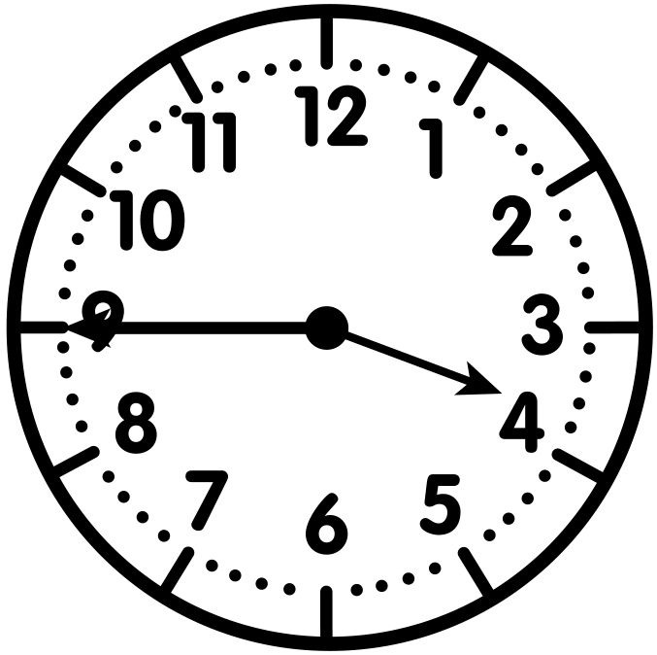
Problem #2
Sharon went to the mall at the time on the clock. She returned home at 4:26. How long was she gone?
LET’S WORK TOGETHER
Time = 3:45
What time did Sharon go to the mall?
3:30
5:00

Slide 21
Problem #2
Sharon went to the mall at the time on the clock. She returned home at 4:26. How long was she gone?
LET’S WORK TOGETHER
Time = 3:45
Fill in the number line.
Does your number line look like this?
3:30
3:40
3:45
3:50
3:55
4:00
4:05
4:10
4:15
4:20
4:25
4:30
4:35
4:40
4:45
4:50
5:00
3:35
4:55

Slide 22
Problem #2
Sharon went to the mall at the time on the clock. She returned home at 4:26. How long was she gone?
LET’S WORK TOGETHER
Time = 3:45
Label the start and end times.
Jump along the number line to solve.
+5
+5
+5
+5
+5
+5
+5
+5
+1
3:30
3:40
3:45
3:50
3:55
4:00
4:05
4:10
4:15
4:20
4:25
4:30
4:35
4:40
4:45
5:00
3:35
3:45
4:50
4:55
Start Time
4:26
End Time

Slide 23
Problem #2
Sharon went to the mall at the time on the clock. She returned home at 4:26. How long was she gone?
LET’S WORK TOGETHER
Time = 3:45
How long was Sharon gone?
She was gone for 41 minutes.
+5
+5
+5
+5
+5
+5
+5
+5
+1
3:30
3:40
3:45
3:50
3:55
4:00
4:05
4:10
4:15
4:20
4:25
4:30
4:35
4:40
4:45
5:00
3:35
3:45
4:50
4:55
41 minutes
Start Time
4:26
End Time

Slide 24
Problem #2
Sharon went to the mall at the time on the clock. She returned home at 4:26. How long was she gone?
LET’S WORK TOGETHER
Time = 3:45
Can you think of another way to jump along the number line? Explain.
+5
+5
+5
+5
+5
+5
+5
+5
+1
3:30
3:40
3:45
3:50
3:55
4:00
4:05
4:10
4:15
4:20
4:25
4:30
4:35
4:40
4:45
5:00
3:35
3:45
4:50
4:55
41 minutes
Start Time
4:26
End Time

Slide 25
CHECK - IN
What did you notice?
Can you make a connection to anything else you already know? How?
Do you have any questions?

Slide 26
IT’S YOUR TURN

Slide 27
Time to Discuss and
Check Your Answers
How did you solve it?

Slide 28
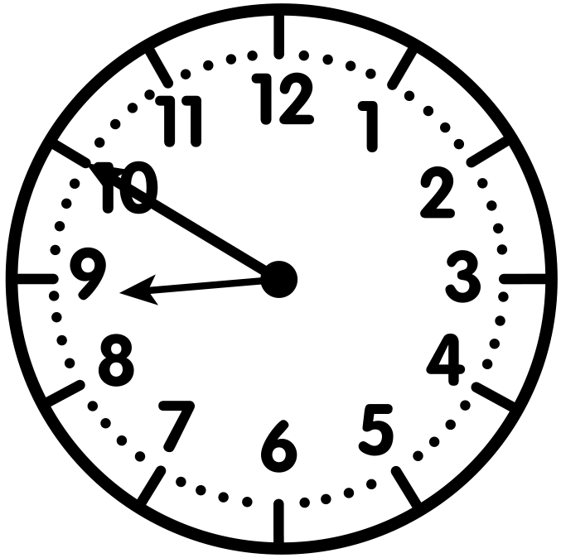
Problem #1
Juan started cooking breakfast at the time on the clock. He finished at 9:17 a.m.
How long did it take Juan to cook breakfast?
YOUR TURN
Time = ________
8:30
8:40
8:45
8:50
8:55
9:00
9:05
9:10
9:15
9:20
9:25
9:30
9:35
9:40
9:45
9:50
10:00
8:35
9:55

Slide 29
Problem #1
Juan started cooking breakfast at the time on the clock. He finished at 9:17 a.m.
How long did it take Juan to cook breakfast?
YOUR TURN
It took Juan 27 minutes to cook breakfast.
Note: Jumps on the number line may vary.
Time = 8:50
+5
+5
+5
+5
+5
+1
+1
8:30
8:50
8:55
9:00
9:05
9:10
9:15
9:20
9:25
9:30
9:35
9:40
9:45
10:00
8:35
8:40
8:45
8:50
9:50
9:55
27 minutes
9:17
Start Time
End Time

Slide 30
Problem #2
YOUR TURN
Bryce went to a basketball game that started at 7:35 p.m. The game ended at 8:55 p.m. Use the number line to determine how long the basketball game lasted.
7:30
7:40
7:45
7:50
7:55
8:00
8:05
8:10
8:15
8:20
8:25
8:30
8:35
8:40
8:45
8:50
9:00
7:35
8:55

Slide 31
Problem #2
YOUR TURN
Bryce went to a basketball game that started at 7:35 p.m. The game ended at 8:55 p.m. Use the number line to determine how long the basketball game lasted.
+10
+10
+10
+10
+10
+10
+10
+10
7:30
7:40
7:45
7:50
7:55
8:00
8:05
8:10
8:15
8:20
8:25
8:30
8:35
8:40
8:45
8:50
9:00
7:35
8:55
80 minutes
Start Time
End Time
The basketball game lasted 80 minutes.
Note: Jumps on the number line may vary.

Slide 32
Problem #3
Max started his homework at the time on the clock. He finished at 4:58 p.m. How long did it take Max to complete his homework?
YOUR TURN
Time = ________
4:00
4:10
4:15
4:20
4:25
4:30
4:35
4:40
4:45
4:50
4:55
5:00
5:05
5:10
5:15
5:20
5:30
4:05
5:25

Slide 33
Problem #3
Max started his homework at the time on the clock. He finished at 4:58 p.m. How long did it take Max to complete his homework?
YOUR TURN
It took Max 53 minutes to complete his homework.
Note: Jumps on the number line may vary.
Time = 4:05
+10
+10
+10
+10
+10
+3
4:00
4:10
4:15
4:20
4:25
4:30
4:35
4:40
4:45
4:50
4:55
5:00
5:05
5:10
5:15
5:20
5:30
4:05
5:25
53 minutes
Start Time
4:58
End Time

Slide 34
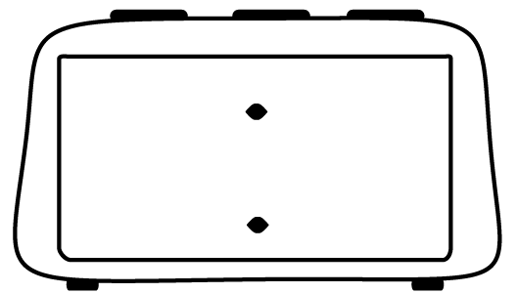
Problem #4
Maggie watched her favorite movie Saturday night. How long was the movie?
YOUR TURN
Start Time
End Time
8:50
10:00
8:30
9:00
9:30
10:00

Slide 35
Problem #4
Maggie watched her favorite movie Saturday night. How long was the movie?
YOUR TURN
Start Time
End Time
8:50
10:00
+10
+10
+10
+10
+10
+10
+10
8:30
8:40
8:45
8:50
8:55
9:00
9:05
9:10
9:15
9:20
9:25
9:30
9:35
9:40
9:45
9:50
10:00
8:35
9:55
70 minutes
Start Time
End Time
The movie was 70 minutes long.
Note: Jumps on the number line may vary.

Slide 36
Let’s Reflect
It’s Reflection Time!

