Slide 1
EXPLORING
TIME
TIME
ELAPSED TIME USING
NUMBER LINES (PART 1)
LESSON 5

Slide 2
TODAY’S OBJECTIVE
Today we will use number
lines to find elapsed time.

Slide 3
TAKE OUT YOUR
MATH JOURNALS
MATH JOURNALS

Slide 4
WATCH ME FIRST

Slide 5
In the previous lesson, we plotted time on number lines.
Today we’ll use number lines to solve elapsed time problems within one hour.
Let’s review elapsed time!

Slide 6
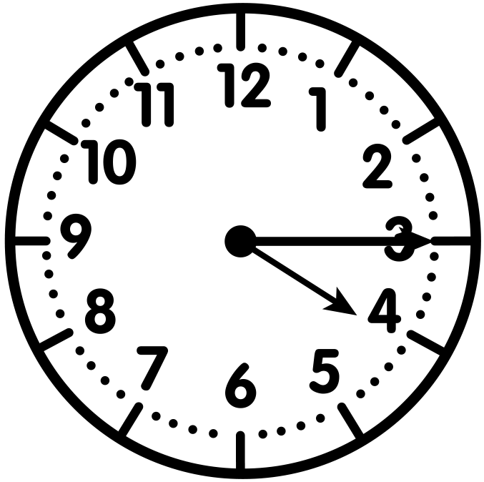
Vocabulary Highlight
Elapsed time is the amount of time that passes from the start of an event until its end.
Start Time - 4:05
End Time - 4:15
This activity is 10 minutes long.

Slide 7
What is a Segment on a Number Line?
Segments are the spaces on a number line between two plotted points or tick marks .
segment
1:00
1:10
1:20
1:30
Each segment represents 10 minutes.

Slide 8
In this lesson, we’ll focus on time problems within one hour where we know the start and end times of an activity.
1:00
2:00

Slide 9
WATCH ME FIRST
Yvette began watching her favorite TV show at 1:15. The show ended at 1:45. How long was the show?
I’ll use a number line that’s divided into equal segments to solve this problem.
Which two hours do 1:15 and 1:45 fall in between?

Slide 10
WATCH ME FIRST
Yvette began watching her favorite TV show at 1:15. The show ended at 1:45. How long was the show?
1:15 and 1:45 fall between 1:00 and 2:00, so I’ll make these my endpoints.
1:00
2:00

Slide 11
WATCH ME FIRST
Yvette began watching her favorite TV show at 1:15. The show ended at 1:45. How long was the show?
Each equal segment in this number line represents a 5-minute interval.
1:00
2:00
5 mins
5 mins
5 mins
5 mins
5 mins
5 mins
5 mins
5 mins
5 mins
5 mins
5 mins
5 mins

Slide 12
WATCH ME FIRST
Yvette began watching her favorite TV show at 1:15. The show ended at 1:45. How long was the show?
Watch me label the times
above each tick mark.
1:00
1:05
1:10
1:15
1:20
1:25
1:30
1:35
1:40
1:45
1:50
1:55
2:00
5 mins
5 mins
5 mins
5 mins
5 mins
5 mins
5 mins
5 mins
5 mins
5 mins
5 mins
5 mins

Slide 13
WATCH ME FIRST
Yvette began watching her favorite TV show at 1:15. The show ended at 1:45. How long was the show?
It’s time to hop along the number line from the start time to the end time to find how much time passed.
+5
+5
+5
+5
+5
+5
1:00
1:05
1:10
1:15
1:25
1:30
1:45
2:00
1:15
1:20
1:35
1:40
1:45
1:50
1:55
Start Time
End Time

Slide 14
WATCH ME FIRST
Yvette began watching her favorite TV show at 1:15. The show ended at 1:45. How long was the show?
I skip counted by five, 6 times.
The TV show was 30 minutes long.
+5
+5
+5
+5
+5
+5
1:00
1:05
1:10
1:15
1:25
1:30
1:45
2:00
1:15
1:20
1:35
1:40
1:45
1:50
1:55
30 minutes
Start Time
End Time

Slide 15
LET’S WORK TOGETHER

Slide 16
Now let’s work together to solve elapsed time problems on a number line.

Slide 17
Problem #1
Ms. Jackson’s class went to recess at 2:05. Recess ended at 2:25. How long was recess?
LET’S WORK TOGETHER
Which hours should we mark as end points on our number line? Explain.
2:05 and 2:25 fall between the hours of 2:00 and 3:00. These will be our end points.
2:00
3:00

Slide 18
Problem #1
Ms. Jackson’s class went to recess at 2:05. Recess ended at 2:25. How long was recess?
LET’S WORK TOGETHER
How many minutes does each equal segment represent in this number line? Explain.
Each segment represents 5 minutes.
2:00
3:00
5 mins
5 mins
5 mins
5 mins
5 mins
5 mins
5 mins
5 mins
5 mins
5 mins
5 mins
5 mins

Slide 19
Problem #1
Ms. Jackson’s class went to recess at 2:05. Recess ended at 2:25. How long was recess?
LET’S WORK TOGETHER
In your Math Journal, fill in the times above each tick mark.
Does your number line look like this?
2:00
2:05
2:10
2:15
2:20
2:25
2:30
2:35
2:40
2:45
2:50
2:55
3:00

Slide 20
Problem #1
Ms. Jackson’s class went to recess at 2:05. Recess ended at 2:25. How long was recess?
LET’S WORK TOGETHER
Label the start and end times on the number line.
Solve in your
Math Journal.
2:00
2:05
2:10
2:15
2:20
2:25
2:30
2:35
2:40
2:45
3:00
2:05
2:25
2:50
2:55
Start Time
End Time

Slide 21
Problem #1
Ms. Jackson’s class went to recess at 2:05. Recess ended at 2:25. How long was recess?
LET’S WORK TOGETHER
Can anyone think of another way to jump along the number line? Explain.
How long was recess?
Recess was 20 minutes long.
+5
+5
+5
+5
2:00
2:05
2:10
2:15
2:20
2:25
2:30
2:35
2:40
2:45
3:00
2:05
2:25
2:50
2:55
20 minutes
Start Time
End Time

Slide 22
LET’S DO ONE MORE TOGETHER…

Slide 23
Problem #2
Chris went to the store at the time on the clock. He got back home at 9:50.
How long was he gone?
LET’S WORK TOGETHER
Time = 9:10
What time did Chris go to the store?

Slide 24
Problem #2
Chris went to the store at the time on the clock. He got back home at 9:50.
How long was he gone?
LET’S WORK TOGETHER
Time = 9:10
Plot the end points on the number line.
9:00
10:00

Slide 25
Problem #2
Chris went to the store at the time on the clock. He got back home at 9:50.
How long was he gone?
LET’S WORK TOGETHER
Time = 9:10
Fill in the number line.
Does your number line look like this?
9:00
9:05
9:10
9:15
9:20
9:25
9:30
9:35
9:40
9:45
9:50
9:55
10:00

Slide 26
Problem #2
Chris went to the store at the time on the clock. He got back home at 9:50.
How long was he gone?
LET’S WORK TOGETHER
Time = 9:10
Label the start and end times.
Jump along the number line to solve.
+5
+5
+5
+5
+5
+5
+5
+5
9:00
9:05
9:10
9:15
9:20
9:25
9:30
9:35
9:40
9:45
9:50
10:00
9:10
9:50
9:55
Start Time
End Time

Slide 27
Problem #2
Chris went to the store at the time on the clock. He got back home at 9:50.
How long was he gone?
LET’S WORK TOGETHER
Time = 9:10
How long was Chris gone?
He was gone for 40 minutes.
+5
+5
+5
+5
+5
+5
+5
+5
9:00
9:05
9:10
9:15
9:20
9:25
9:30
9:35
9:40
9:45
9:50
10:00
9:10
9:50
9:55
40 minutes
Start Time
End Time

Slide 28
CHECK - IN
What did you notice?
Can you make a connection to anything else you already know? How?
Do you have any questions?

Slide 29
IT’S YOUR TURN

Slide 30
Time to Discuss and
Check Your Answers
How did you solve it?

Slide 31
Problem #1
Alicia started cooking dinner at the time on the clock. She finished at 4:55 p.m.
How long did it take Alicia to cook dinner?
YOUR TURN
Time = ________
4:00
5:00

Slide 32
Problem #1
Alicia started cooking dinner at the time on the clock. She finished at 4:55 p.m.
How long did it take Alicia to cook dinner?
YOUR TURN
It took Alicia 30 minutes to cook dinner.
Time = 4:25
+5
+5
+5
+5
+5
+5
4:00
4:05
4:10
4:15
4:20
4:25
4:30
4:35
4:40
4:45
4:50
4:55
5:00
30 minutes
Start
Time
End
Time

Slide 33
Problem #2
YOUR TURN
Jim started cleaning his room at 7:05 a.m. He finished at 7:25 a.m. Use the number line to determine how long it took Jim to clean.
7:00
7:05
7:10
7:15
7:20
7:25
7:30
7:35
7:40
7:45
7:50
7:55
8:00

Slide 34
Problem #2
YOUR TURN
Jim started cleaning his room at 7:05 a.m. He finished at 7:25 a.m. Use the number line to determine how long it took Jim to clean.
+5
+5
+5
+5
7:00
7:05
7:10
7:15
7:20
7:25
7:30
7:35
7:40
7:45
7:50
7:55
8:00
20 minutes
Start
Time
End
Time
It took Jim 20 minutes to clean his room.

Slide 35
Problem #3
Rob’s break started at the time on the clock. His break ended at 11:30 a.m.
How long was his break?
YOUR TURN
Time = ________
11:00
12:00

Slide 36
Problem #3
Rob’s break started at the time on the clock. His break ended at 11:30 a.m.
How long was his break?
YOUR TURN
Time = 11:05
Rob’s break was 25 minutes.
+5
+5
+5
+5
+5
11:00
11:05
11:10
11:15
11:20
11:25
11:30
11:35
11:40
11:45
11:50
11:55
12:00
25 minutes
Start
Time
End
Time

Slide 37
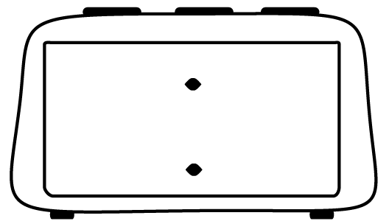
Problem #4
How long was the school’s Awards Day assembly?
YOUR TURN
Awards Day
Start Time
Awards Day
End Time
10:00
10:55
10:00
11:00

Slide 38
Problem #4
How long was the school’s Awards Day assembly?
YOUR TURN
Awards Day
Start Time
Awards Day
End Time
10:00
10:55
+5
+5
+5
+5
+5
+5
+5
+5
+5
+5
+5
10:00
10:05
10:10
10:15
10:20
10:25
10:30
10:35
10:40
10:45
10:50
10:55
11:00
55 minutes
Start
Time
End
Time
The assembly was 55 minutes.

Slide 39
Let’s Reflect
It’s Reflection Time!

