Slide 1
What I Will Learn
TEKS 4.10B
Calculate Profit in a given situation
Sales Price
You will meet 6 entrepreneurs and see a product each one creates. Calculate the profit earned for selling each product.
Costs
Profit
©Melissa Johnson www.Marvel Math.com

Slide 2
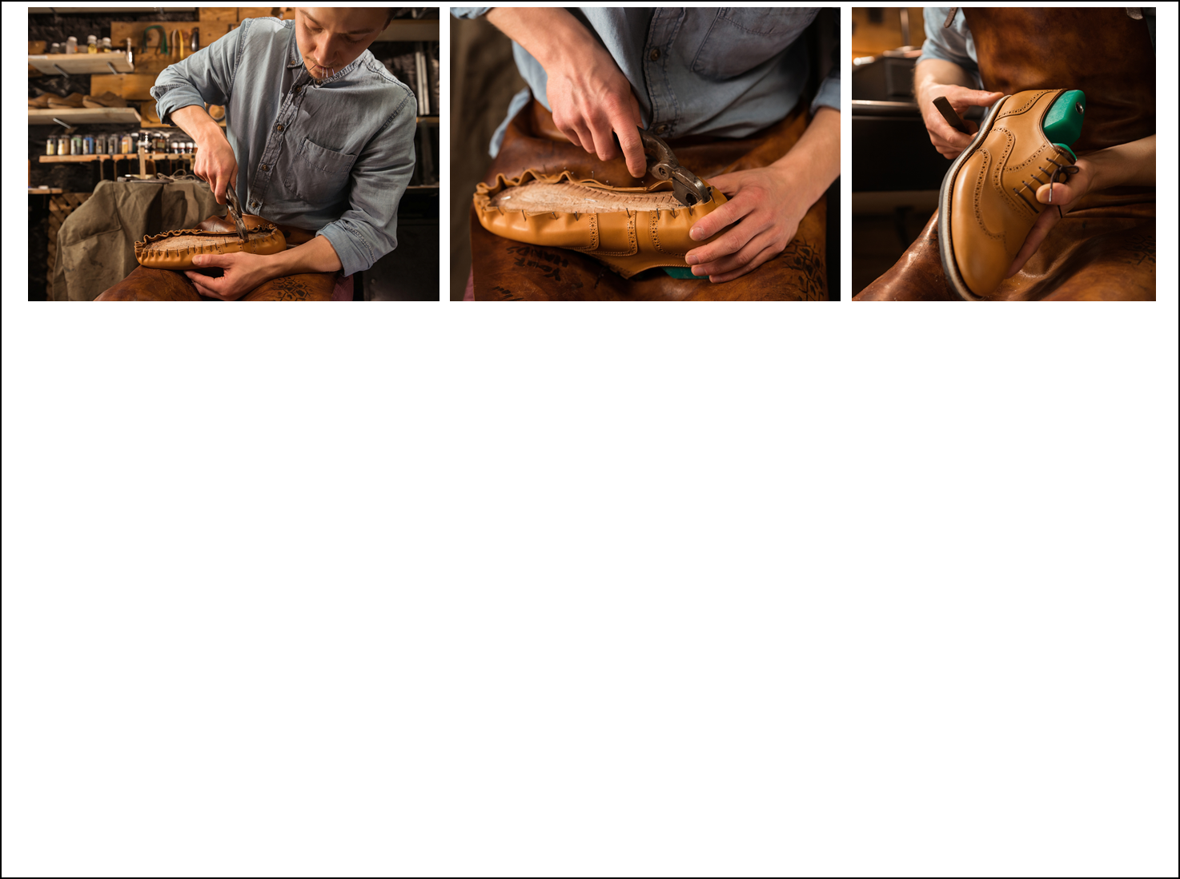
Louis makes custom shoes for customers.
Here are the costs he has for making a pair of shoes:
Leather: $24.75
Sole of Shoes: $13.40
Laces: $4.50
He sells each pair of shoes for $139. What is Louis’ profit?
24.75
13.40
+ 4.50
Find the total cost to make the product.
42.65
Subtract the total cost from the sales price.
139.00
- 42.65
The result is
Louis’ profit.
$96.35
©Melissa Johnson www.Marvel Math.com

Slide 3
Lilliana knits unique blankets.
Here are the costs she had for creating a blanket:
Wool: $43.06
Packaging: $9
Shipping Cost: $14.92
She sold the blanket on Etsy for $155 including shipping. What was Lilliana’s profit?
43.06
9.00
+ 14.92
Find the total cost to make a blanket.
66.98
Subtract the total cost from the sales price.
155.00
- 66.98
The result is
Lilliana’s profit.
$88.02
©Melissa Johnson www.Marvel Math.com

Slide 4
Kara designs websites for customers.
Here are the costs she has for creating a website:
Clip art/Photos : $449.99
E-commerce software: $325
Domain Registration: $14.99
She charges her customers $2,500 to create a website. What is Kara’s profit?
449.99
325.00
+ 14.99
Find the total cost to make a website.
789.98
Subtract the total cost from the sales price.
2,500.00
- 789.98
The result is
Kara’s profit.
$1,710.02
©Melissa Johnson www.Marvel Math.com

Slide 5
David sells floral arrangements.
Here are the costs he has for creating a floral arrangement:
Flowers: $34.62
Greenery: $13.50
Vase: $10
He charges $105 per floral arrangement. What is David’s profit?
34.62
13.50
+ 10.00
Find the total cost to make a floral arrangement.
58.12
Subtract the total cost from the sales price.
105.00
- 58.12
The result is
David’s profit.
$46.88
©Melissa Johnson www.Marvel Math.com

Slide 6
Dominique designs dresses for celebrities.
Here are the costs she had for creating a dress:
Fabric: $286.56
Beading: $583.90
Notions: $24.56
She sold that dress for $2,200. What was Dominique’s profit?
286.56
583.90
+ 24.56
Find the total cost to create the dress.
895.02
Subtract the total cost from the sales price.
2,200.00
- 895.02
The result is
Dominique’s profit.
$1,304.98
©Melissa Johnson www.Marvel Math.com

Slide 7
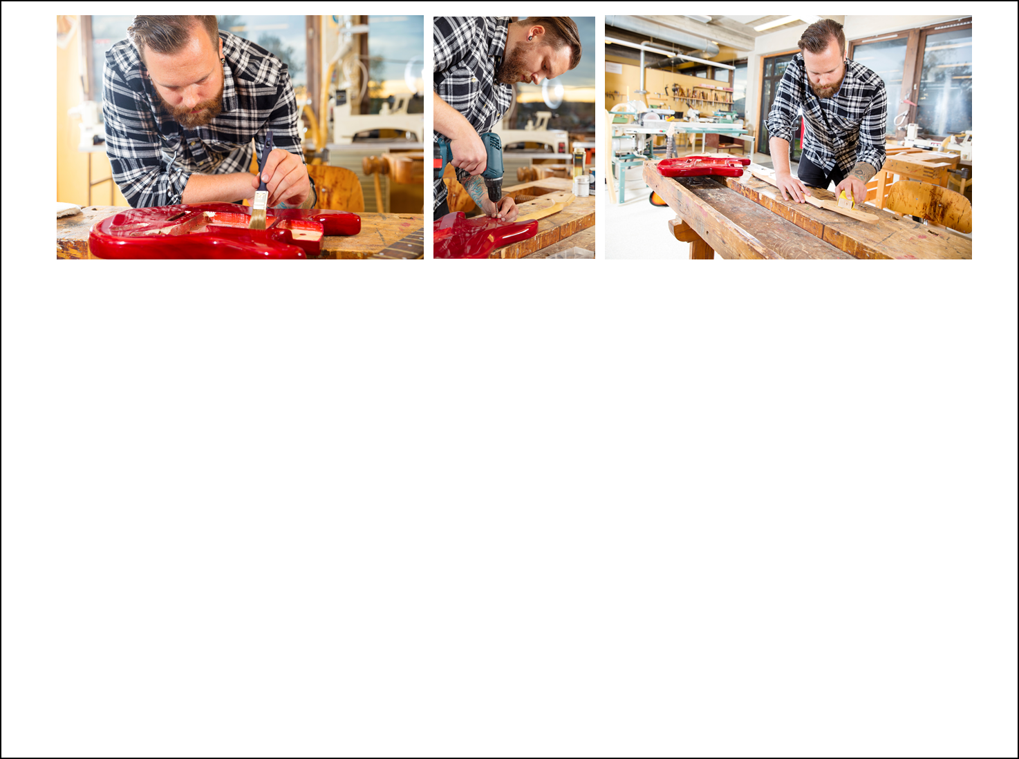
Ivan builds guitars.
Here are the costs he had for building a guitar:
Wood: $78.05
Paint: $16.92
Hardware: $58.29
He sold the guitar for $1,550. What was Ivan’s profit?
78.05
16.92
+ 58.29
Find the total cost to build a guitar.
153.26
Subtract the total cost from the sales price.
1,550.00
- 153.26
The result is
Ivan’s profit.
$1,396.74
©Melissa Johnson www.Marvel Math.com

Slide 8
What I Learned
TEKS 4.10B
Calculate Profit in a given situation
Sales Price
Can you think of a product you would like to create and sell? You may be a future entrepreneur!
Costs
Profit
©Melissa Johnson www.Marvel Math.com

