Slide 1
What I Will Learn
TEKS 4.10E
I will learn the basic purpose of financial institutions, including keeping money safe, borrowing money,
and lending.
$
©Melissa Johnson www.Marvel Math.com

Slide 2
How Banks Work
People, businesses and governments deposit money into banks.
©Melissa Johnson www.Marvel Math.com

Slide 3
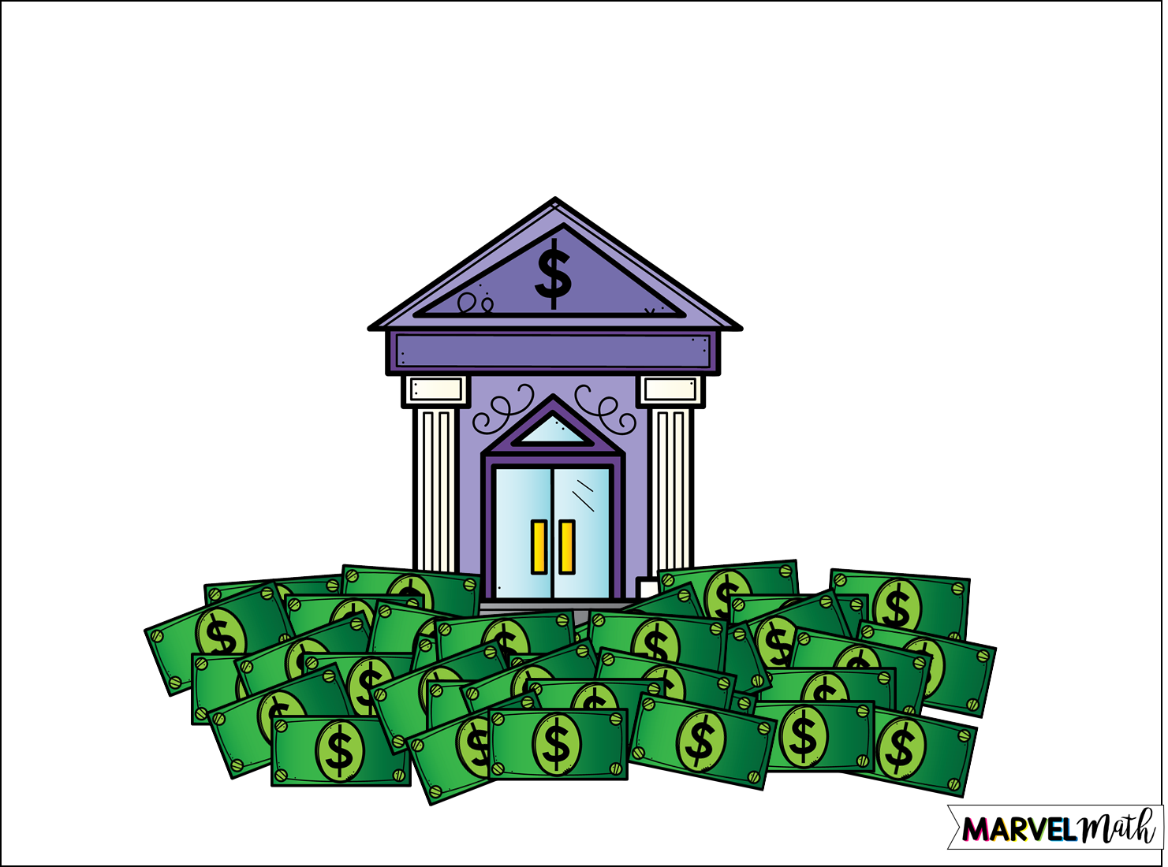
Banks pool the money they receive from deposits.
©Melissa Johnson www.Marvel Math.com

Slide 4
Then banks lend money to people to buy homes or cars, or to businesses or governments for large projects or purchases.
©Melissa Johnson www.Marvel Math.com

Slide 5
Customers who have borrowed money make loan payments each month to the bank. They pay back part of the loan plus interest every month.
©Melissa Johnson www.Marvel Math.com

Slide 6
The bank collects the money from loan payments.
©Melissa Johnson www.Marvel Math.com

Slide 7
The bank pays a small amount of interest each month on the money that has been deposited into savings accounts and CDs.
Beginning Balance | $100.00
Beginning Balance | $1,000.00
Beginning Balance | $500.00
Interest Earned
$0.85
Interest Earned
$8.50
Interest Earned
$4.25
Ending Balance
$100.85
Ending Balance
$1,008.50
Ending Balance
$504.25
©Melissa Johnson www.Marvel Math.com

Slide 8
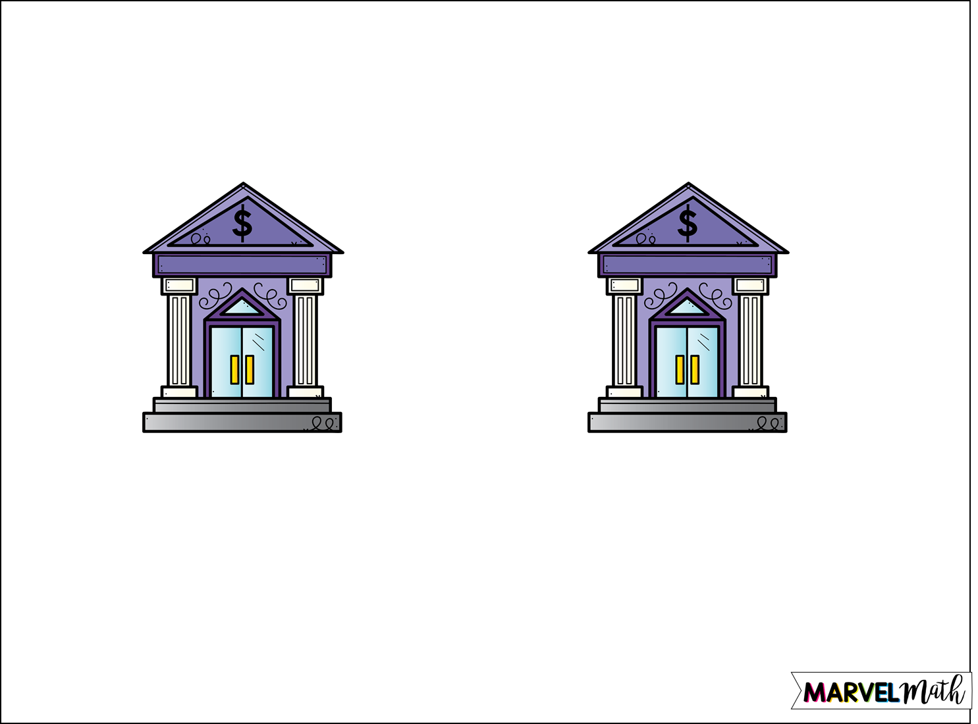
Banks and Credit Unions both accept deposits and loan money. How are they different?
Credit Union
Bank
Credit unions are non-profit organizations. Most of the time they charge less interest on loans and pay better interest on deposits.
Banks are for profit businesses. Most of the time they charge more interest on loans and pay less interest on deposits.
©Melissa Johnson www.Marvel Math.com

Slide 9
Ed wants to take out a loan for $25,000 to buy a Jeep. He went to a credit union and a bank to find out how much he would pay in interest.
Car Loan: 3.5% interest charged
Car Loan:
4.2% interest charged
Credit Union
Bank
Loan Amount: $25,000
Total Interest: $2,287.62
Total Ed will pay: $27,287.62
Loan Amount: $25,000
Total Interest: $2,760.37
Total Ed will pay: $27,760.37
*Please note that these are sample rates and that actual rates vary greatly based on borrower’s credit score, whether the car is new or used and if the car is purchased from a dealer or private owner. The interest paid is compounded for a 5 year loan.
©Melissa Johnson www.Marvel Math.com

Slide 10
Kay wants to deposit $10,000 into a savings account. She went to a credit union and a bank to find out what she could earn in interest.
Savings:
0.25% interest earned in 1 year
Savings:
0.03% interest earned in 1 year
Credit Union
Bank
Deposit Amount: $10,000
Total Interest Earned: $25
Ending Balance: $10,025
Deposit Amount: $10,000
Total Interest Earned: $3
Ending Balance: $10,003
*These are the actual percentage rates for Randolph Brooks Federal Credit Union vs. Bank of America for April 2019. Please note that simple interest was calculated for this slide, while banks often compound interest daily.
©Melissa Johnson www.Marvel Math.com

Slide 11
What I Learned
I learned how banks and credit unions:
Accept deposits
Pool the money from deposits
Loan money
Accept loan payments for the amount of money loaned plus interest
Pay interest to people who have deposited money in savings accounts
©Melissa Johnson www.Marvel Math.com

