Slide 1
What I Will Learn
TEKS 4.10C
I will learn the advantages and disadvantages of various savings options.
©Melissa Johnson www.Marvel Math.com

Slide 2
Savings Options
You will learn about 5 different savings options.
Piggy Bank
Savings Account
Certificate of Deposit (CD)
Bond
Stock Market
For each option you will learn:
The Potential to Earn Money
The Risk of Losing Money
Access to Your Money
©Melissa Johnson www.Marvel Math.com

Slide 3
Piggy Bank
You can put money you save into a piggy bank.
What is the potential to earn money?
Can I lose money?
Do I have access to my money?
You won’t earn any money on the amount saved in a piggy bank.
You will not lose money unless someone steals it or you misplace it.
Your money is very accessible.
©Melissa Johnson www.Marvel Math.com

Slide 4
Savings Account
You can put money you save into a savings account.
What is the potential to earn money?
Can I lose money?
Something to Know:
A government agency called the FDIC insures money deposited at banks in the United States. Your bank pays for this insurance on your behalf. If a bank is robbed or goes out of business, you will not lose any money.
Usually you earn less than 1% interest on money you put into savings. The potential to earn money is low.
You can not lose money you put into a savings account, unless you have more than $250,000 at a single bank.
©Melissa Johnson www.Marvel Math.com

Slide 5
Savings Account
You can put money you save into a savings account.
What is the potential to earn money?
Can I lose money?
Do I have access to my money?
Usually you earn less than 1% interest on money you put into savings. The potential to earn money is low.
You cannot lose money you put into a savings account, unless you have more than $250,000 at a single bank.
Your money is accessible. You can withdraw money from your account at any time.
©Melissa Johnson www.Marvel Math.com

Slide 6
Certificate of Deposit
You can put money you save into a certificate of deposit, which is also called a CD or sometimes just a certificate.
What is the potential to earn money?
Can I lose money?
Do I have access to my money?
You usually earn 2-3% interest on your money. The longer the length of the CD and the more money you deposit, the more interest you can earn.
You will not lose money (up to $250,000) because these are FDIC insured accounts.
Your money is not accessible until your CD matures. If you take out your money early, you must pay a fee.
©Melissa Johnson www.Marvel Math.com

Slide 7
Certificate of Deposit
CDs vary in length from 3 months
to 10+ years.
You put a set amount of money into a CD. You can’t continue to deposit money into it. (Although you can open another CD.)
If you commit to keeping your money in a CD for a longer period of time, the bank will give you a higher interest rate.
©Melissa Johnson www.Marvel Math.com

Slide 8
Certificate of Deposit
Here are 3 examples of
CD lengths and interest rates:
1 year
CD
5 year
CD
10 year
CD
2.45%
Earned
$1,000 deposited will be worth
$1,024.50 in one year.
2.85%
Earned
$1,000 deposited will be worth
$1,028.50 in one year*.
3. 1 %
Earned
$1,000 deposited will be worth
$1,031.00 in one year*.
*This is what your money will be worth after one year, even though you can’t withdraw the money until the 5 or 10 year period is over.
©Melissa Johnson www.Marvel Math.com

Slide 9
Savings Account vs. Certificate of Deposit
Think about the basic purpose of banks. Banks accept deposits (and keep them safe), pool that money and then loan it out to others.
Why would a bank offer a higher interest rate on a CD than a savings account?
Banks use higher interest rates as an incentive. This way deposits are more likely to remain for an extended period of time, giving banks the opportunity to make loans to others.
©Melissa Johnson www.Marvel Math.com

Slide 10
Meet Jasmine
Jasmine is 1 1 years old. She has $5,000 saved for college. She plans to start withdrawing money when she turns 18.
Which savings option is better for Jasmine?
Savings Account
7 year CD
0.08 % Earned:
$5,000 deposited will be worth $5,028.07 in 7 years.
3. 1 % Earned:
$5,000 deposited will be worth $6,191.28 in 7 years.
©Melissa Johnson www.Marvel Math.com

Slide 11
Meet Edgar
Edgar is 15 years old. He wants to start saving money to buy a car. He will deposit his paychecks into an account and withdraw the money in 18 months.
Which savings option is better for Edgar?
Only a savings account gives Edgar the option to deposit paychecks during the next 18 months. He will not earn much in interest, but the money will be in the bank helping reduce the temptation to spend while he is saving for a car.
Savings Account
18 month CD
0.08 % Earned
$5,000 deposited will be worth $5,006.00 in 18 months.
2.2% Earned
$5,000 deposited will be worth $5,167.75 in 18 months.
©Melissa Johnson www.Marvel Math.com

Slide 12
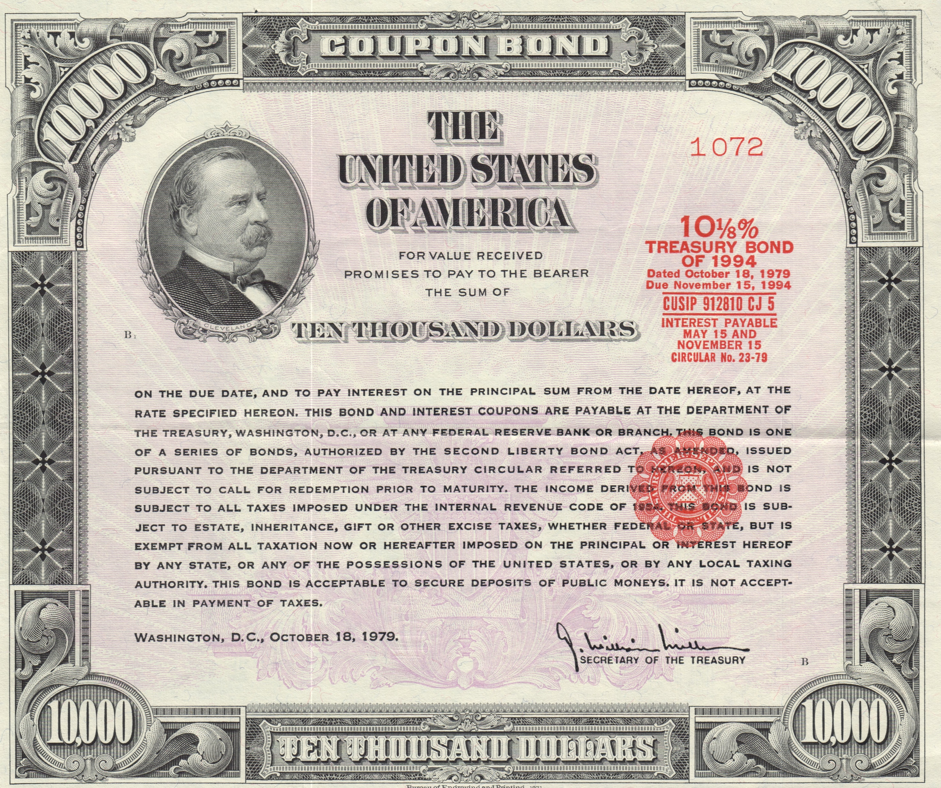
Bonds
The most common bonds are U.S. Treasury Bonds.
What is the potential to earn money?
Can I lose money?
Do I have access to my money?
If you buy a U.S. Treasury bond for $1,000 today, it will be worth $2,000 in 20 years. The potential to earn money is low based on the length of time.
There is no risk on buying most bonds, because they are usually insured.
You don’t have access to your money. You can’t cash in your bond early.
©Melissa Johnson www.Marvel Math.com

Slide 13
Meet Grace
Grace is 4 years old. She received $20,000 from a relative. The money will be put into savings for 20 years.
Grace today.
Grace in 20 years.
When Grace is 24 and has graduated from college she will be allowed to withdraw the money from savings.
©Melissa Johnson www.Marvel Math.com

Slide 14
Meet Grace
Which of these savings options is best for Grace?
U.S.
Treasury Bond
Savings Account
20 year CD
0.08 % Earned:
$20,000 deposited will be worth $20,322.44 in 20 years.
3.5 % Earned:
$20,000 deposited will be worth $39,795.78 in 20 years.
$20,000 spent will get a bond worth $40,000 in 20 years.
©Melissa Johnson www.Marvel Math.com

Slide 15
Stock Market
You can invest your savings in the stock market.
What is the potential to earn money?
Can I lose money?
Do I have access to my money?
There is moderate to high potential to make money by buying stocks. Earnings vary greatly, but wise investing could earn 8-12% of its value each year.
You could lose some or all of your money.
You can sell stocks Monday-Friday, but if your stocks’ price dropped you may want to wait for the price to go up.
©Melissa Johnson www.Marvel Math.com

Slide 16
Stock Market
Here are 2 examples of what can happen to money invested in the stock market.
You made $19,211.61
Stock Name: AAPL
Company: Apple
Stock Name: JCP
Company:
JC Penny
$10,000 of stock purchased 4-17-2009 is worth
$29,211.61 ten years later.
$10,000 of stock purchased 4-17-2009 is worth
$515.81 ten years later.
You lost $9,484.19
©Melissa Johnson www.Marvel Math.com

Slide 17
Smart Savers
Smart savers usually don’t put all of their money in one place.
Many people have money saved in savings accounts, CD’s and the stock market.
©Melissa Johnson www.Marvel Math.com

Slide 18
Meet Mr. & Mrs. Davis
They have $20,000 in savings.
They want $4,000 to be accessible at all times for unexpected bills like car repairs and medical expenses.
They would like to put $10,000 in an account that will make interest, but is not at risk of being lost. They are planning to use this money towards a down payment on a house in 3 years.
They would like the remaining $6,000 to earn as much money as possible, even if there is risk.
©Melissa Johnson www.Marvel Math.com

Slide 19
Mr. & Mrs. Davis
Consider the first savings need.
They want $4,000 to be accessible at all times for unexpected bills like car repairs and medical expenses.
Which savings option is best for this money?
This is the only option that leaves money fully accessible for unexpected expenses.
Savings Account
3 year CD
Stock Market
0.08 % Earned
2.85 % Earned
Could earn BIG.
Could lose it ALL.
©Melissa Johnson www.Marvel Math.com

Slide 20
Mr. & Mrs. Davis
Consider the next savings need.
They would like to put $10,000 in an account that will make interest, but is not at risk of being lost. They are planning to use this money towards a down payment on a house in 3 years.
Which savings option is best for this money?
Money will earn better interest than a savings account
Money will not be at risk of being lost.
Savings Account
3 year CD
Stock Market
0.08 % Earned
2.85 % Earned
Could earn BIG.
Could lose it ALL.
©Melissa Johnson www.Marvel Math.com

Slide 21
Mr. & Mrs. Davis
Consider their last savings need.
They would like the remaining $6,000 to earn as much money as possible, even if there is some risk.
Which savings option is best for this money?
This option has the biggest risk, but can also have the biggest reward.
Savings Account
3 year CD
Stock Market
0.08 % Earned
2.85 % Earned
Could earn BIG.
Could lose it ALL.
©Melissa Johnson www.Marvel Math.com

Slide 22
Extend your Learning
We can’t predict the future of stocks, but we can see what they have done in the past. Use the “What if” calculator HERE to see what money invested earlier is worth today for all of your favorite companies.
Do you want to see how your money can grow over time? Use the savings calculator HERE.
©Melissa Johnson www.Marvel Math.com

Slide 23
What did I learn?
I learned about 5 different savings options.
Piggy Bank
Savings Account
Certificate of Deposit (CD)
Bond
Stock Market
For each option I learned:
The Potential to Earn Money
The Risk of Losing Money
Access to Your Money
©Melissa Johnson www.Marvel Math.com

