Slide 1
What I Will Learn
TEKS 4.10D
I will describe how to allocate weekly allowance among spending, saving, including for college, and sharing.
Saving
Sharing
Spending
©Melissa Johnson www.Marvel Math.com

Slide 2
Your Money
When you receive your allowance, you should think about more than just spending it. Think about 3 categories to split your money between.
Let’s talk about the savings jar!
Saving
Save money for larger purchases, for college, and to invest.
©Melissa Johnson www.Marvel Math.com

Slide 3
Saving
What can you do with money you are saving?
Put it into a savings account.
Invest your money in the stock market.
Put it into a Certificate of Deposit (CD).
Buy a U.S. Treasury Bond
©Melissa Johnson www.Marvel Math.com

Slide 4
Saving
What are things people save for?
College
Home
Emergency Fund
Large
Purchases
Car
Vacation
Start a Business
©Melissa Johnson www.Marvel Math.com

Slide 5
Your Money
The next category to consider is…
Let’s talk about what your sharing jar can do!
Saving
Sharing
Save money for larger purchases, for college, and to invest.
Give money to help others who are in need.
©Melissa Johnson www.Marvel Math.com

Slide 6
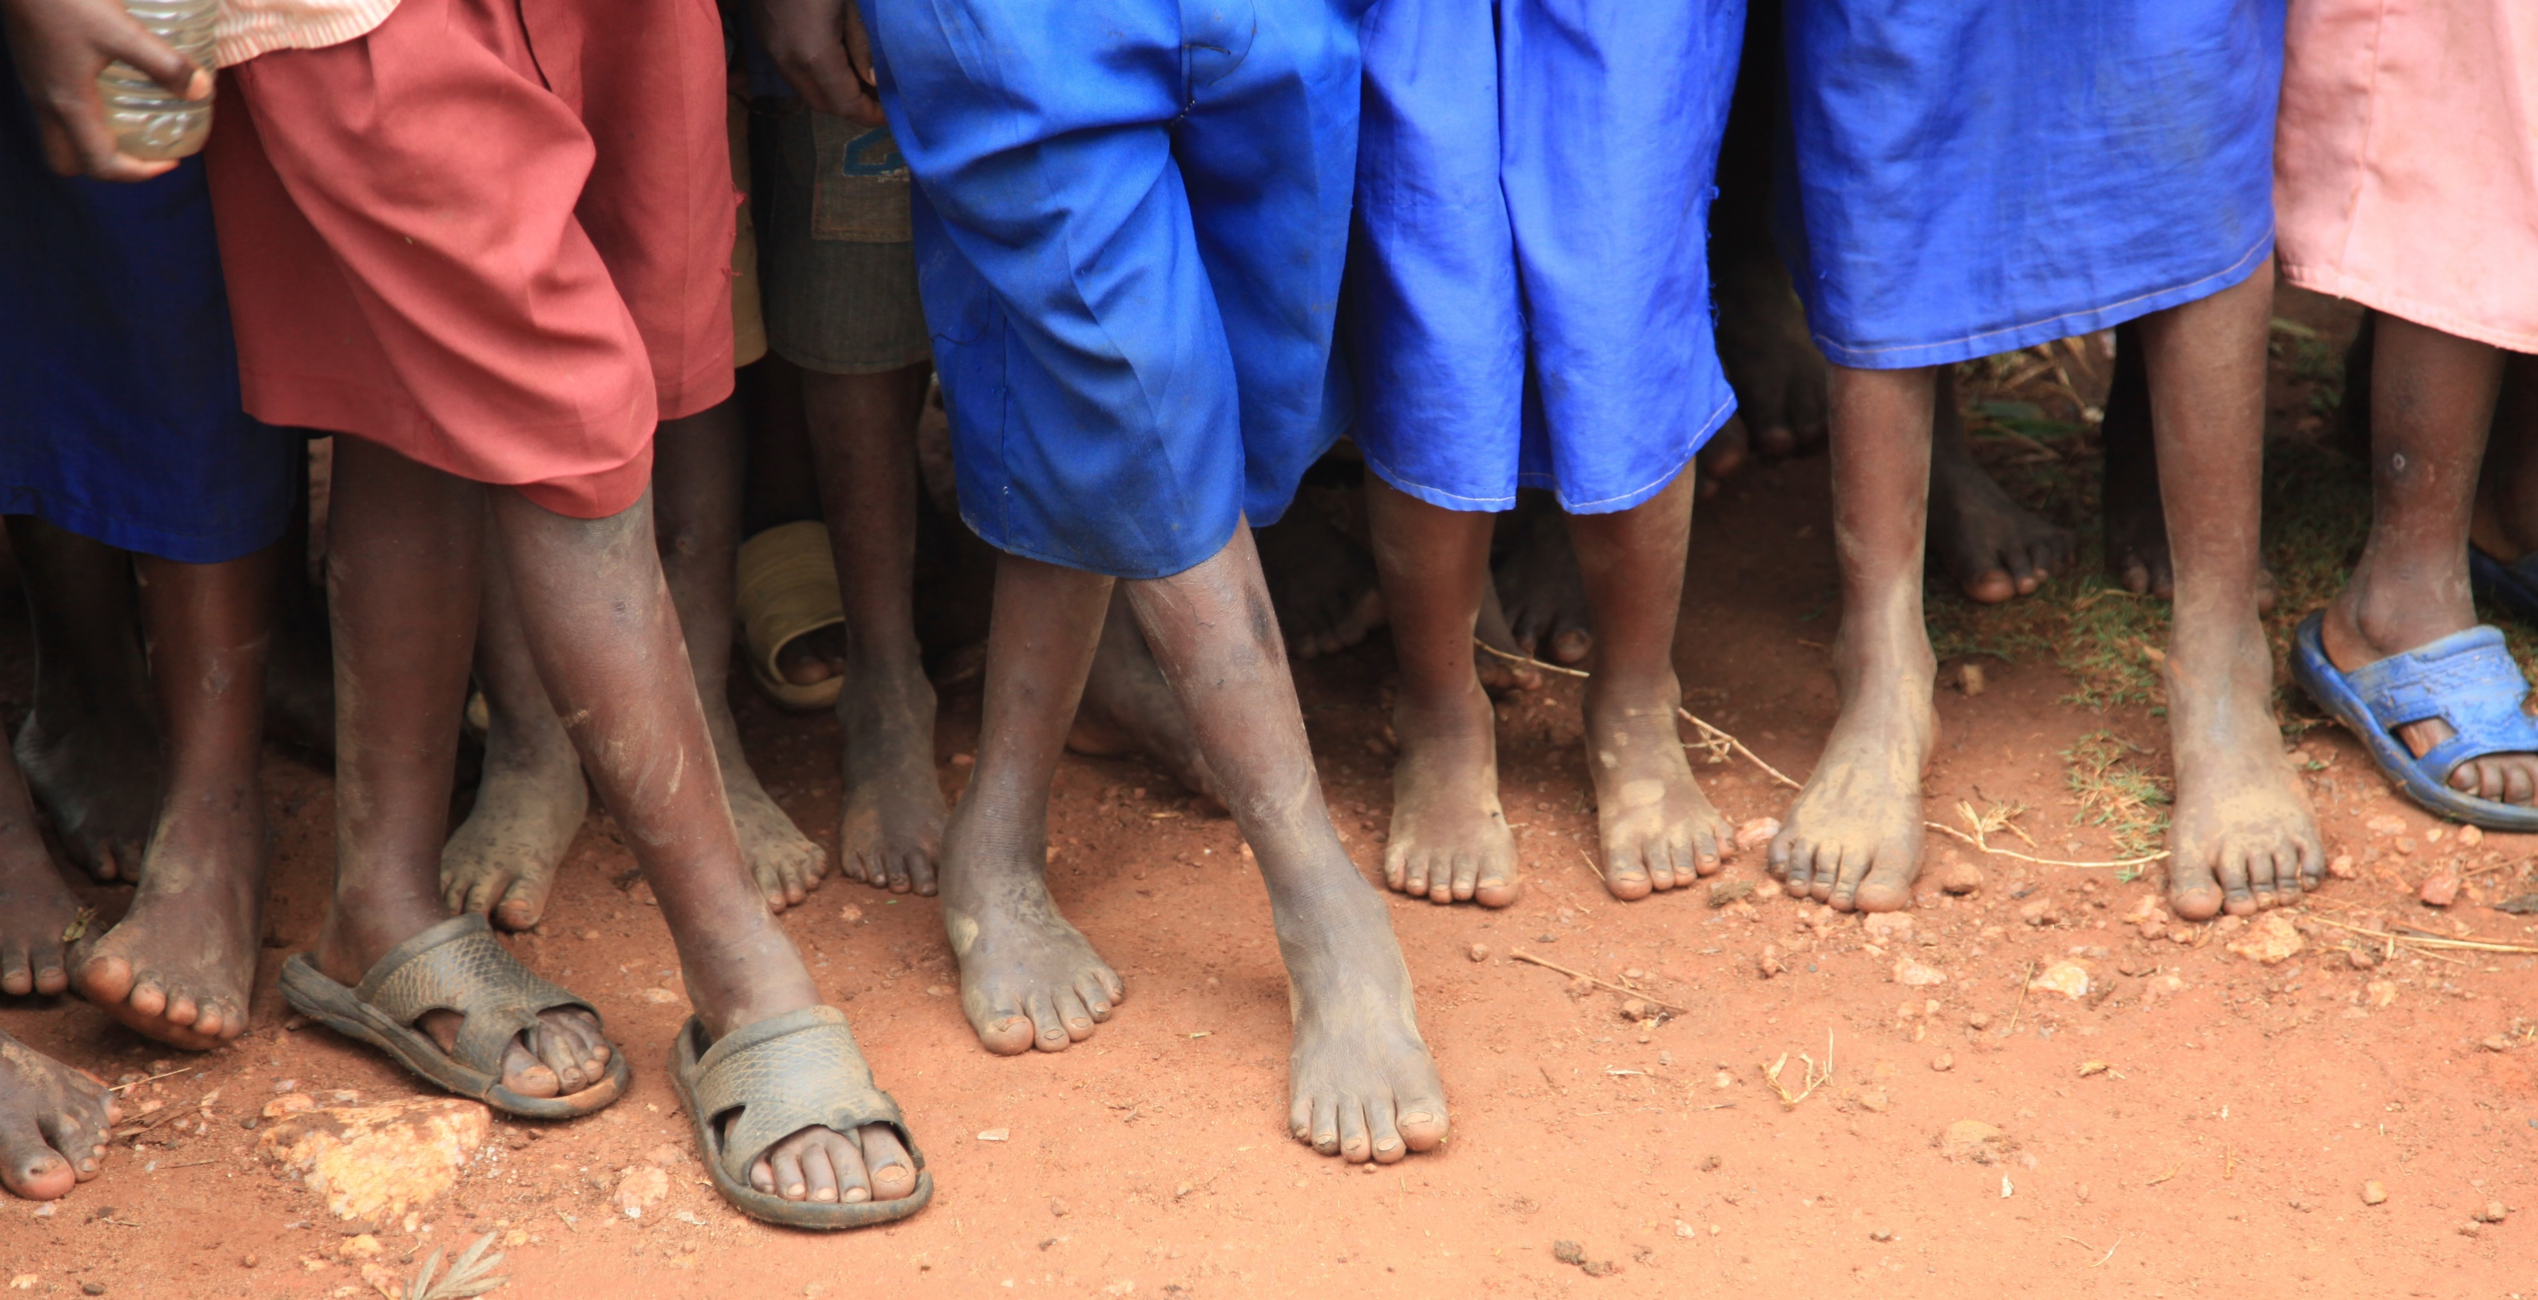
Sharing
Why should I give money to others?
You can change others lives!!!
You don’t have to look far to find someone who has a need that they can’t meet alone. We don’t live in a perfect world, and at one time or another we all need help in some way. Being part of a community means helping when you can.
©Melissa Johnson www.Marvel Math.com

Slide 7
Sharing: Habitat for Humanity
How is this organization helping others?
Habitat for Humanity helps provide housing for families who don’t have a home. People in need can apply for home ownership through Habitat for Humanity. If selected, they will invest hundreds of hours of their own labor, called sweat equity, while they work alongside volunteers to build their home. When it is complete, the homeowners pay back an affordable mortgage (often less than their previous rent) to cover some of the cost to build their home.
Michelle, a Habitat for Humanity volunteer lays tile in a Habitat house.
Want to read a first hand story of how this organization changed the direction of someone’s life? Click HERE.
©Melissa Johnson www.Marvel Math.com

Slide 8
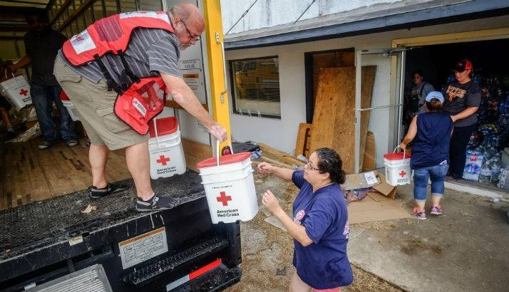
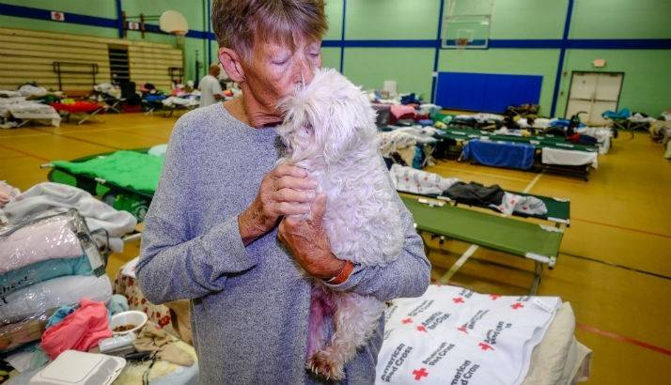
Sharing: The Red Cross
How is this organization helping others?
The American Red Cross helps families in need because of a disaster. 90% of the disasters the Red Cross responds to are home fires, but they are also well known for helping families affected by hurricanes, floods and wildfires. The Red Cross works with local partners (usually cities and churches) to open shelters, provide meals, and help families rebuild after a disaster has taken everything from them.
Volunteers deliver supplies to help with clean-up in Tivoli Texas, a town hit by Hurricane Harvey.
How many meals did the Red Cross provide to families after Hurricane Harvey hit Texas? Click HERE to find out.
A woman and her dog stay at a Red Cross shelter in Corpus Christi after her home was destroyed by Hurricane Harvey.
©Melissa Johnson www.Marvel Math.com

Slide 9
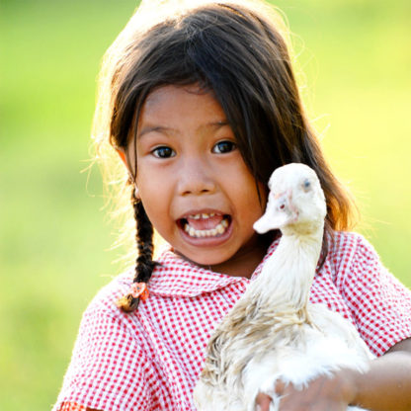
Sharing: World Vision
How is this organization helping others?
World vision is an organization focused on changing communities, especially the lives of children. They focus on the poorest areas of the world and use sustainable projects to bring lasting change. Rather than giving food, they give a family a means to supply food that will continue. This helps maintain the dignity of those they help and has a greater long-term impact.
A girl holds a duck given to her family through World Vision. Her family can’t afford to buy enough food. This duck will produce several hundred protein-rich eggs every year to feed her. Extra eggs can be sold to buy shoes, medicine and school supplies.
Want to know how donating money to buy a goat can completely change a families’ life? Watch the video HERE.
©Melissa Johnson www.Marvel Math.com

Slide 10
Sharing
Each of these organizations, and thousands of others, operate with money donated by people like you. Donating to an organization isn’t the only way to give, but these organizations are experts in helping people with specific types of needs. Over many years of hard work they have determined how to maximize the impact of each dollar donated.
©Melissa Johnson www.Marvel Math.com

Slide 11
Your Money
The third category to consider is…
Let’s talk about spending wisely!
Saving
Sharing
Spending
Save money for larger purchases, for college, and to invest.
Give money to help others who are in need.
Spend money on your needs and then your wants as your budget allows.
©Melissa Johnson www.Marvel Math.com

Slide 12
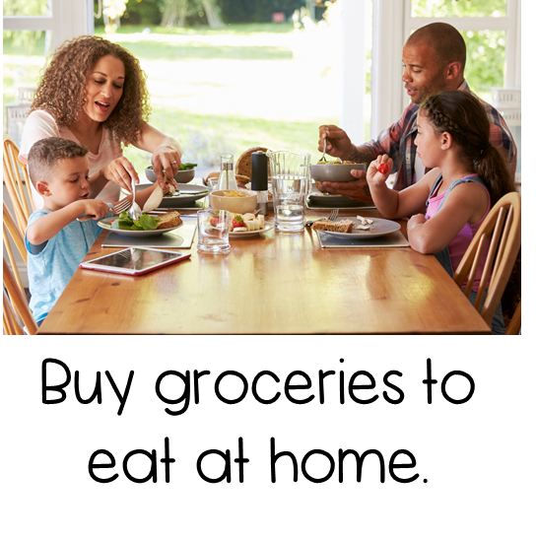
Spending
What should I spend money on?
Spend money on needs first.
Then spend money on wants.
©Melissa Johnson www.Marvel Math.com

Slide 13
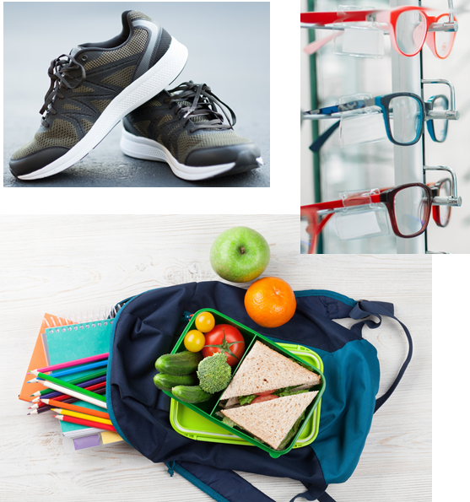
Spending
Wise spending means having self control.
Purchase the things you need.
If there is still money in your spending jar, spend it on wants.
©Melissa Johnson www.Marvel Math.com

Slide 14
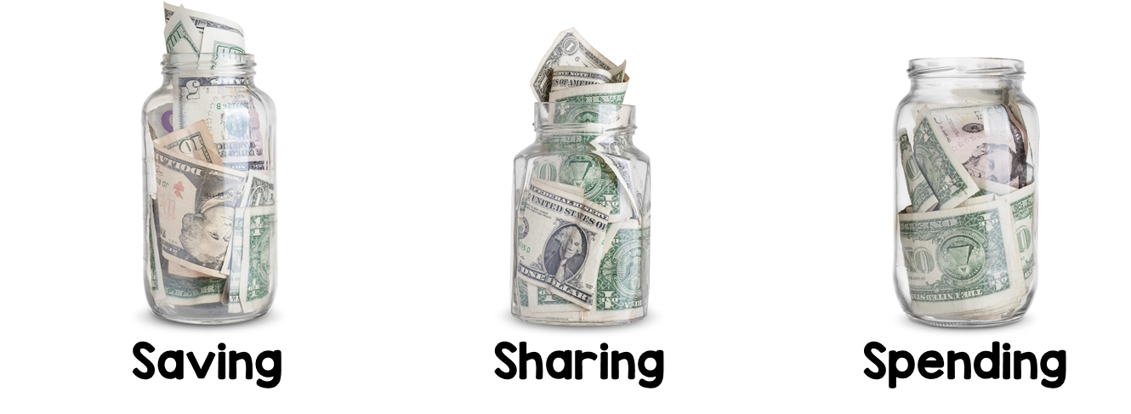
Your Money
How much should go in each jar?
Many experts have different opinions. Most experts recommend children save about half of their allowance, while adults should save 20% or more of their income. This is because as children our parents pay for things we need like a place to live, food and clothes.
©Melissa Johnson www.Marvel Math.com

Slide 15
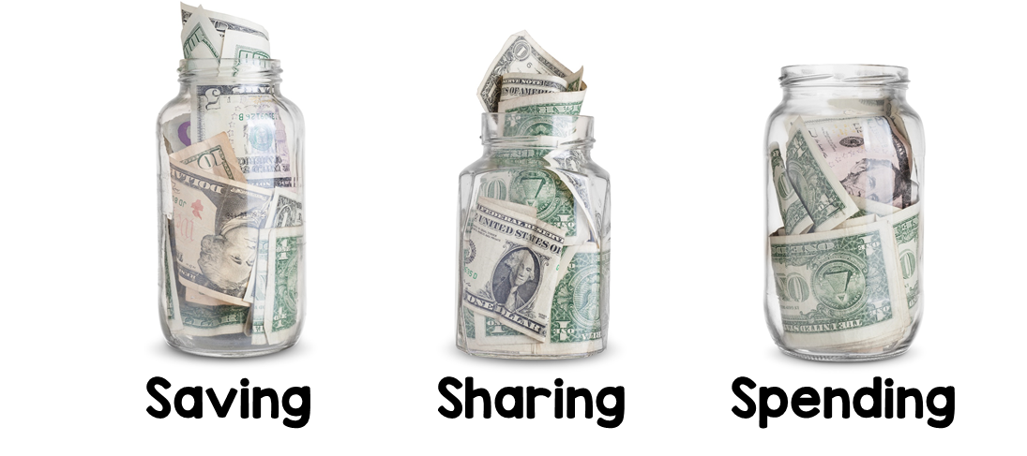
Your Money
How much should go in each jar?
Dave Ramsey
(a financial advisor) recommends these percentages for kids.
40%
20%
40%
The percentages will be different for each person. Discuss your opinions as a class, then individually write the percent you will put in each jar on your recording sheet.
(All 3 should add up to 100%)
What do you think?
% means out of 100.
So, 40% means 40¢ out of $1,
$4 out of $10 or $40 out of $100.
©Melissa Johnson www.Marvel Math.com

Slide 16
Good Advice
Smart money management follows 4 rules:
Spend less
Save more
Invest wisely
Give generously
-Barbara Stanny in Forbes Magazine
©Melissa Johnson www.Marvel Math.com

Slide 17
What Did I Learn?
TEKS 4.10D
I can describe how to allocate weekly allowance among spending, saving, including for college, and sharing.
Saving
Sharing
Spending
©Melissa Johnson www.Marvel Math.com

